Slide 1





Data Preprocessing

Slide 2

Hello!
I am Eslam Ahmed
I am a software engineer.
You can find me at jeksogsa@gmail.com

Slide 3

Hello!
I am Eman Ehab
I am a ML research engineer.
You can find me at emanehab.ieee@gmail.com

Slide 4
Agenda
What is Data
Machine Learning
Data Preprocessing
Feature Engineering and Extraction
Domain knowledge features
Date and Time features
String operations
Web Data
Geospatial features
Work with Text
Work with Images
Work with Audio
Dimension Reduction with PCA
Feature Transformations
Data Cleaning or Cleansing
Work with Missing data
Work with Categorical data
Detect and Handle Outliers
Split data to Train and Test Sets
Deal with Imbalanced classes
Feature Scaling
How to use Pipelines
Feature Selection

Slide 5
Agenda
What is Data
Machine Learning
Data Preprocessing
Feature Engineering and Extraction
Domain knowledge features
Date and Time features
String operations
Web Data
Geospatial features
Work with Text
Work with Images
Work with Audio
Dimension Reduction with PCA
Feature Transformations
Data Cleaning or Cleansing
Work with Missing data
Work with Categorical data
Detect and Handle Outliers
Split data to Train and Test Sets
Deal with Imbalanced classes
Feature Scaling
How to use Pipelines
Feature Selection

Slide 6




What is Data
We are living in a data-driven economy. It’s a world
where having tons of data, understanding it and
knowing what to do with data is power.
Understanding your data is not one of the most difficult
things in data science, but it is time-consuming.
Interpretation of data is effective when we know about
the source of data.

Slide 7
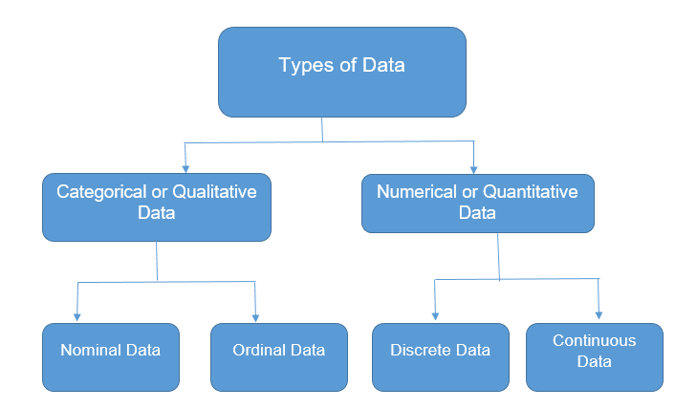
What is Data (Types of Data)
Categorical
This represents qualitative data with no apparent
inherent mathematical meaning.
Example: Yes or No, Sex, Race, Marital Status etc.
These can take be assigned numbers like Yes(0) and
No(1), but numbers have no mathematical meaning.
Numerical
This represents some sort of quantitative
measurement.
Example: height of people, stock price, page load time etc

Slide 8
What is Data (Numerical)
Discrete data
This is integer based, often counts of some event.
Example: “How many songs do a user like?” or
“How many times a coin flipped to “head” ?”
Continuous data
It has an infinite number of
possible values. Example: “How much time did it
take for a user to buy?”

Slide 9
What is Data (Categorical)
Nominal or unordered data
we assign individual items to named categories that do
not have an implicit or natural value or rank.
Example: Animals can be cats or dogs or horses etc..
that would be nominal data.
Ordered or ordinal data
items are assigned to categories that do have some kind
of implicit or natural order.
Example: “Small, Medium, or Large." Another example is a
survey question that asks us to rate an item on a 1 to 10
scale, with 10 being the best. This implies that 10 is better
than 9, which is better than 8, and so on.

Slide 10
Agenda
What is Data
Machine Learning
Data Preprocessing
Feature Engineering and Extraction
Domain knowledge features
Date and Time features
String operations
Web Data
Geospatial features
Work with Text
Work with Images
Work with Audio
Dimension Reduction with PCA
Feature Transformations
Data Cleaning or Cleansing
Work with Missing data
Work with Categorical data
Detect and Handle Outliers
Split data to Train and Test Sets
Deal with Imbalanced classes
Feature Scaling
How to use Pipelines
Feature Selection

Slide 11

Machine Learning
Machine learning involves computers discovering how
they can perform tasks without being explicitly
programmed to do so. It involves computers learning
from data provided so that they carry out certain tasks.

Slide 12
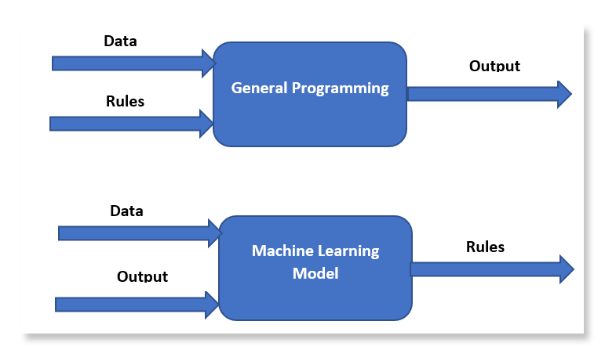

Machine Learning

Slide 13
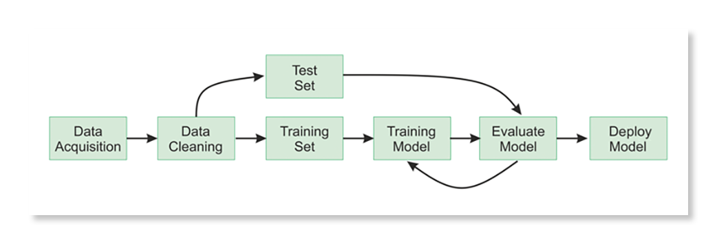
Machine Learning

Slide 14
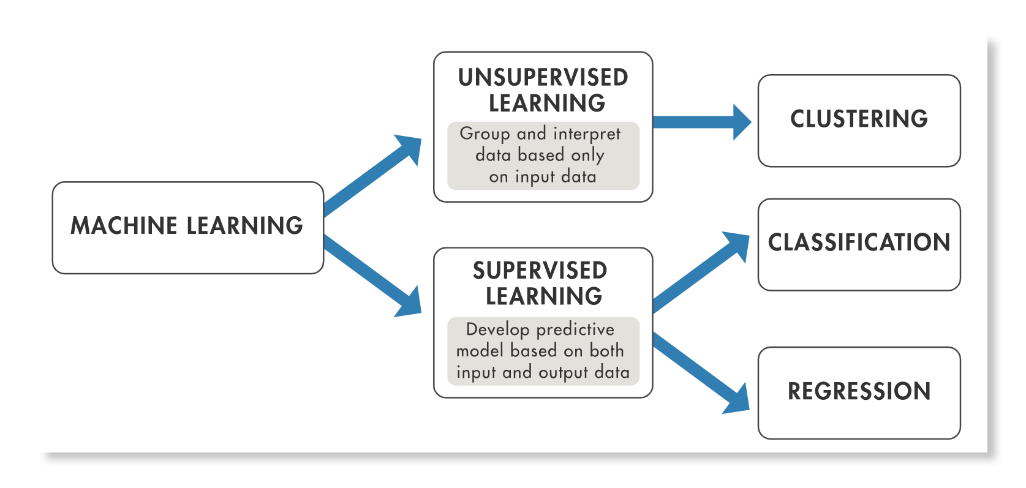
Machine Learning

Slide 15
Agenda
What is Data
Machine Learning
Data Preprocessing
Feature Engineering and Extraction
Domain knowledge features
Date and Time features
String operations
Web Data
Geospatial features
Work with Text
Work with Images
Work with Audio
Dimension Reduction with PCA
Feature Transformations
Data Cleaning or Cleansing
Work with Missing data
Work with Categorical data
Detect and Handle Outliers
Split data to Train and Test Sets
Deal with Imbalanced classes
Feature Scaling
How to use Pipelines
Feature Selection

Slide 16
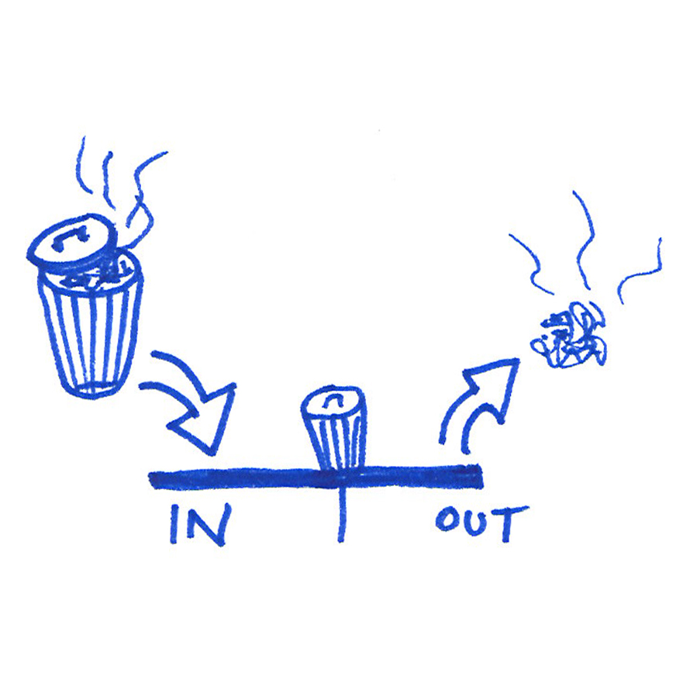
Data Preprocessing
The phrase "garbage in, garbage out" is the best
description for the use of data preprocessing.
Data gathering methods are often loosely
controlled, resulting in out-of-range values, useless
features, outliers, missing values, etc.
Garbage data produce misleading results. Thus, data
preprocessing is the most important phase of a
machine learning project.

Slide 17
Data Preprocessing
Feature Engineering and Extraction
Extract and Create useful features from raw data into
features suitable for modeling.
Feature Transformation
Transformation of data to improve the accuracy of the
algorithm.
Feature Selection
Removing unnecessary features.

Slide 18
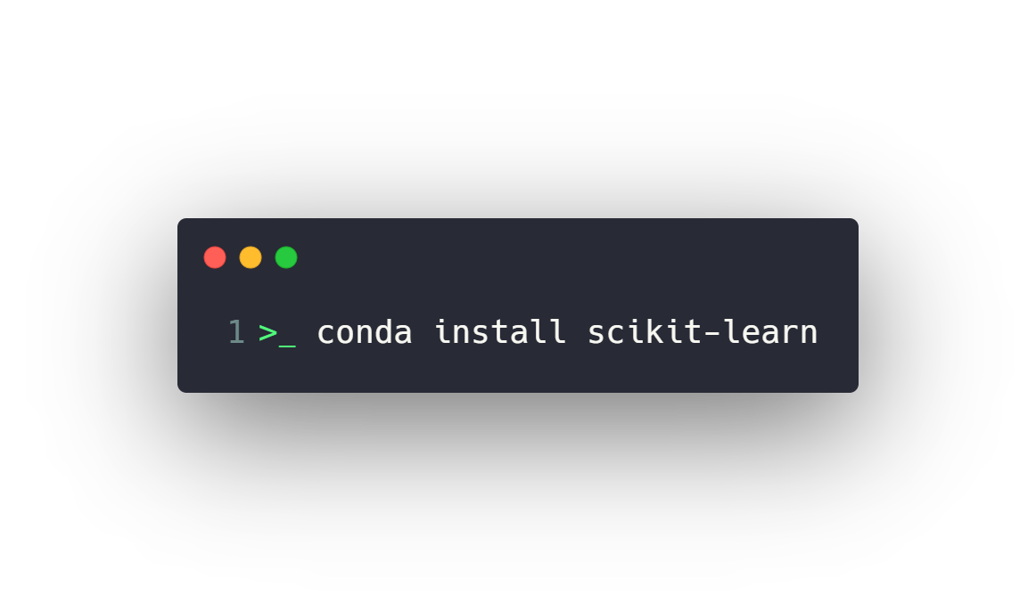
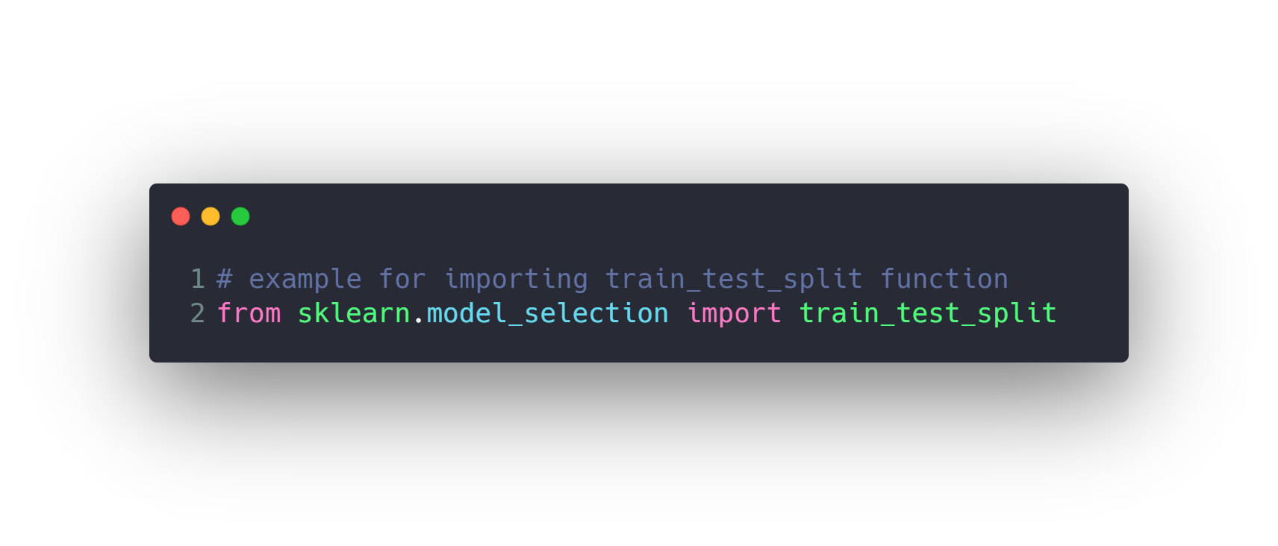
Data Preprocessing
Install
Use

Slide 19
Agenda
What is Data
Machine Learning
Data Preprocessing
Feature Engineering and Extraction
Domain knowledge features
Date and Time features
String operations
Web Data
Geospatial features
Work with Text
Work with Images
Work with Audio
Dimension Reduction with PCA
Feature Transformations
Data Cleaning or Cleansing
Work with Missing data
Work with Categorical data
Detect and Handle Outliers
Split data to Train and Test Sets
Deal with Imbalanced classes
Feature Scaling
How to use Pipelines
Feature Selection

Slide 20
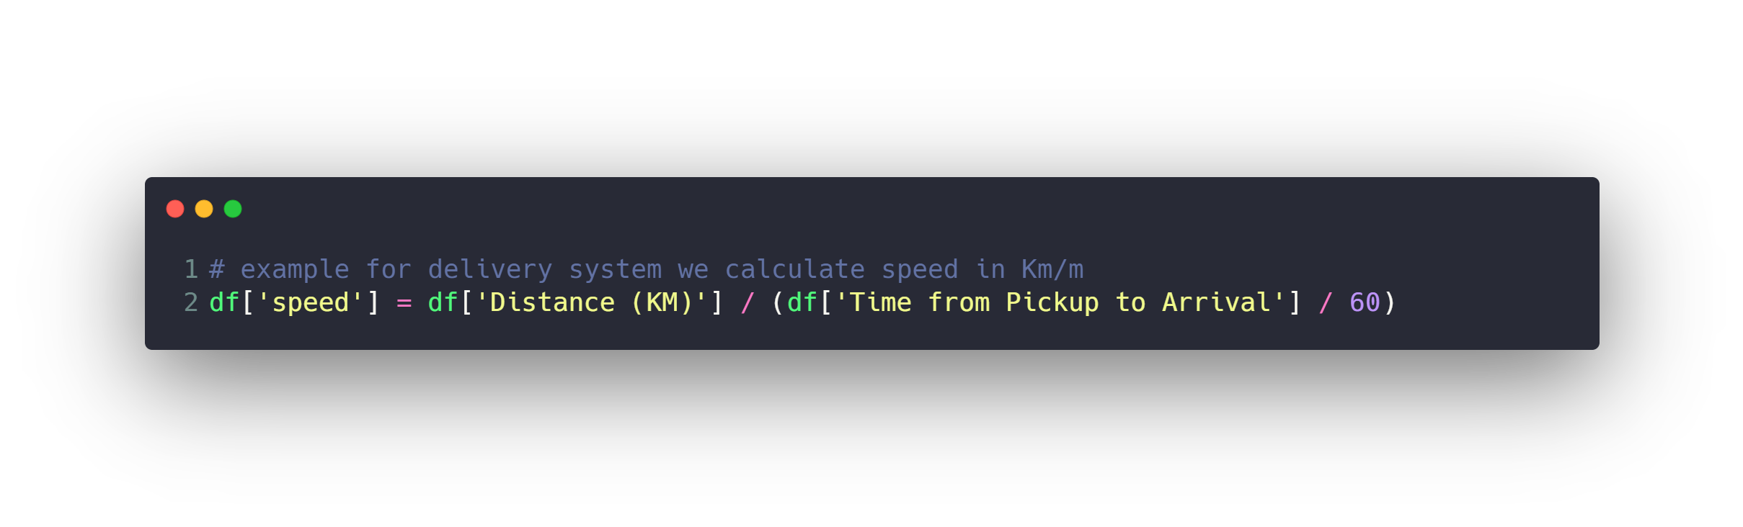
Domain knowledge features
It's the process of creating new useful features from current
features based on our understanding of the problem domain
knowledge.

Slide 21
Agenda
What is Data
Machine Learning
Data Preprocessing
Feature Engineering and Extraction
Domain knowledge features
Date and Time features
String operations
Web Data
Geospatial features
Work with Text
Work with Images
Work with Audio
Dimension Reduction with PCA
Feature Transformations
Data Cleaning or Cleansing
Work with Missing data
Work with Categorical data
Detect and Handle Outliers
Split data to Train and Test Sets
Deal with Imbalanced classes
Feature Scaling
How to use Pipelines
Feature Selection

Slide 22
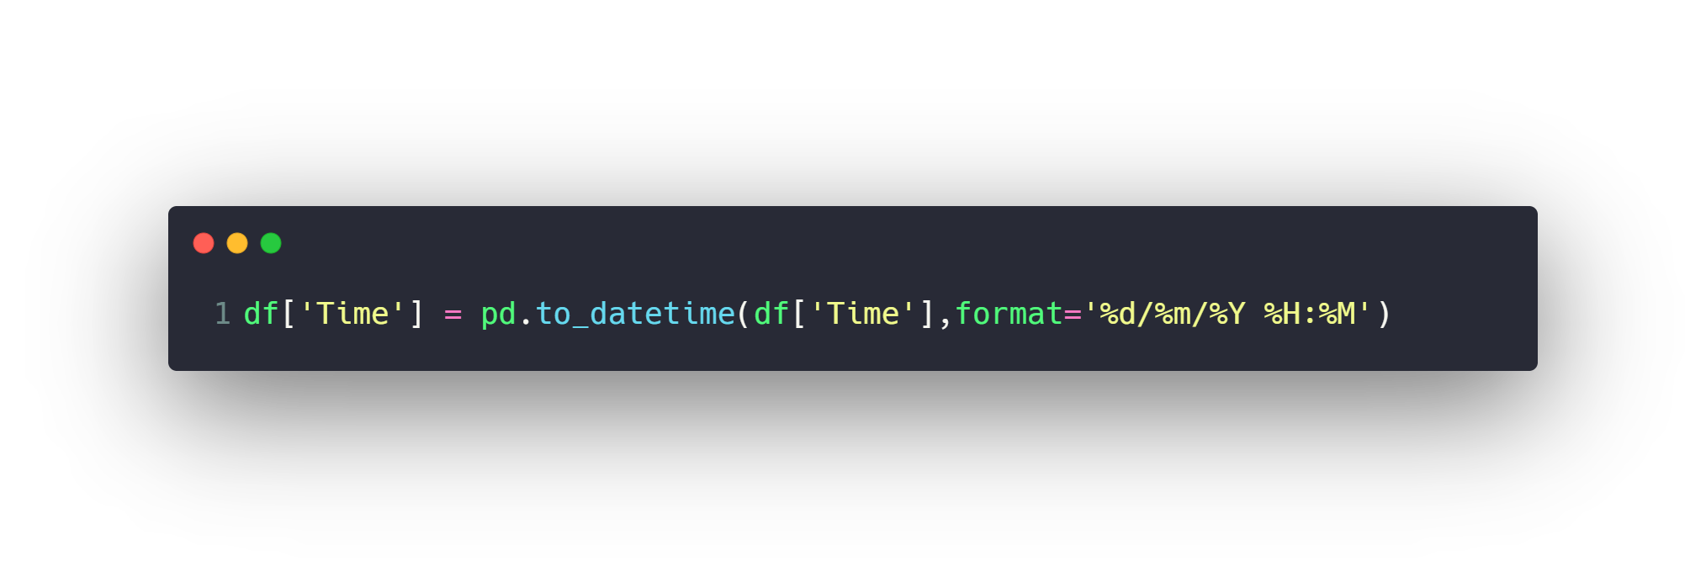
Date and Time features
Date columns usually provide valuable information about
the problem, they are neglected as an input for the machine
learning algorithms. It might be the reason for this, that
dates can be present in numerous formats, which make it
hard to understand by algorithms.

Slide 23
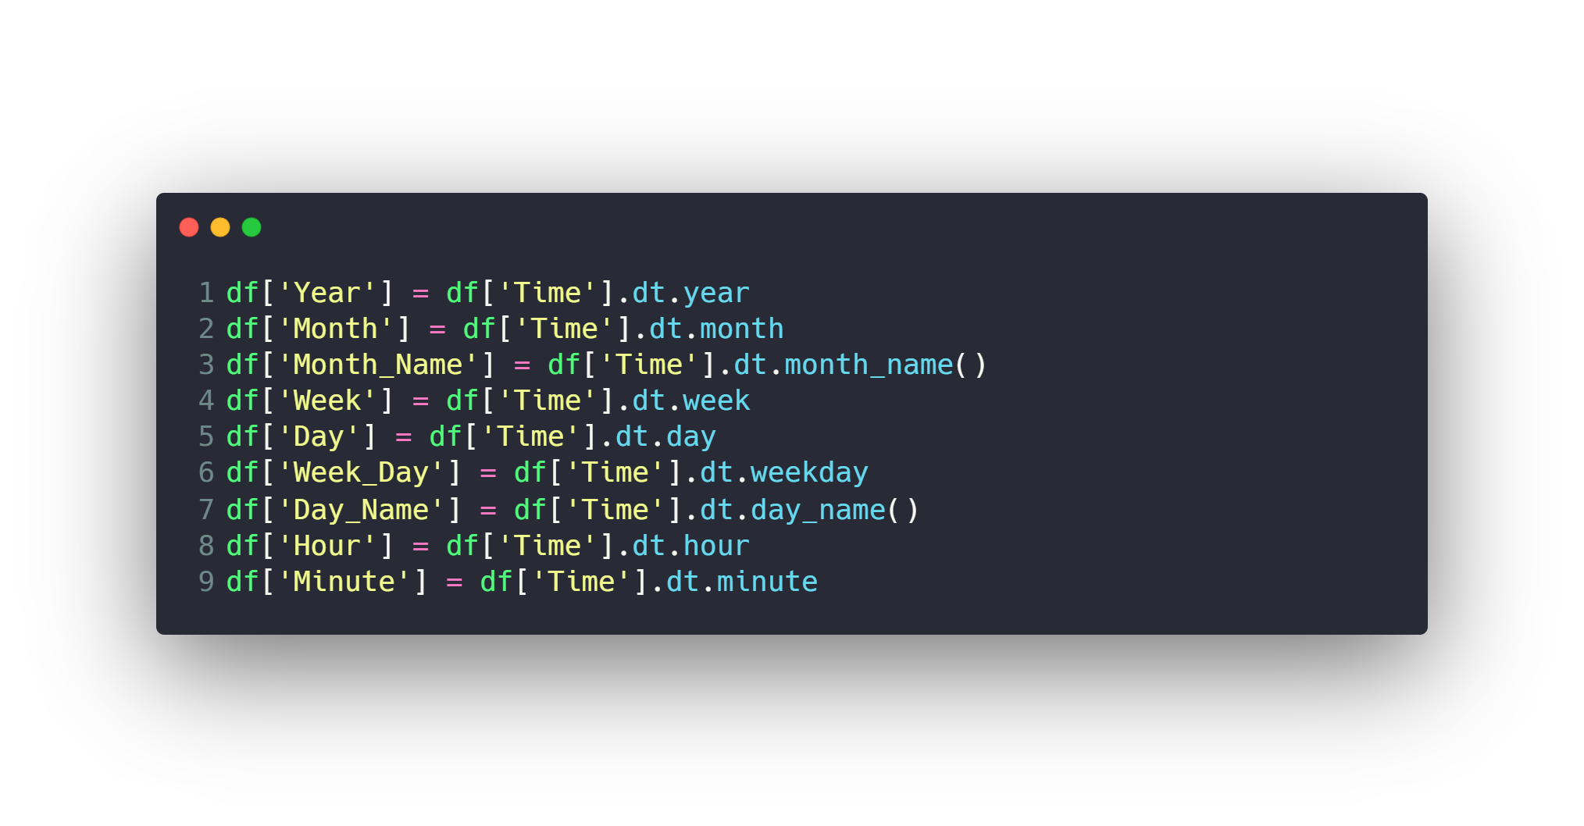
Date and Time features
Extract day, hour, minute, seconds, quarter, month, year, etc.
Extract time-based features like evenings, noon, night time etc.
Extract seasonal features like winter, summer, autumn.
Calculate time elapsed between two related Date features.

Slide 24
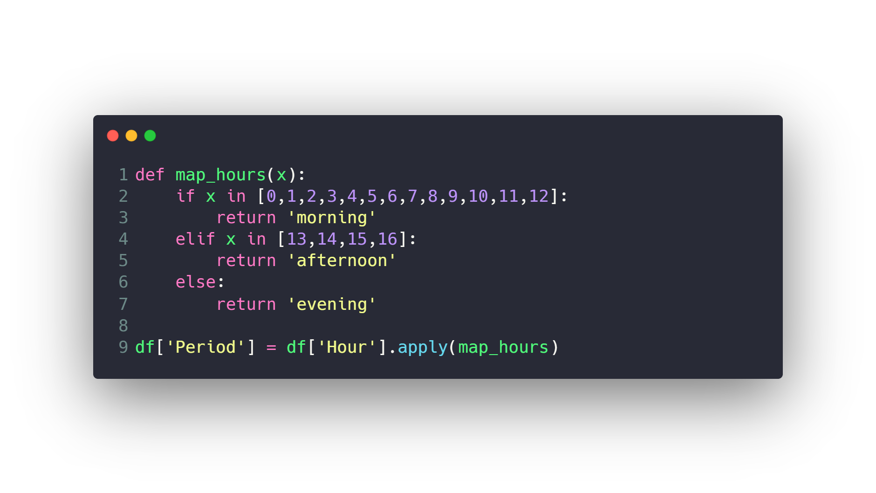
Date and Time features
Extract day, hour, minute, seconds, quarter, month, year, etc.
Extract time-based features like evenings, noon, night time etc.
Extract seasonal features like winter, summer, autumn.
Calculate time elapsed between two related Date features.

Slide 25
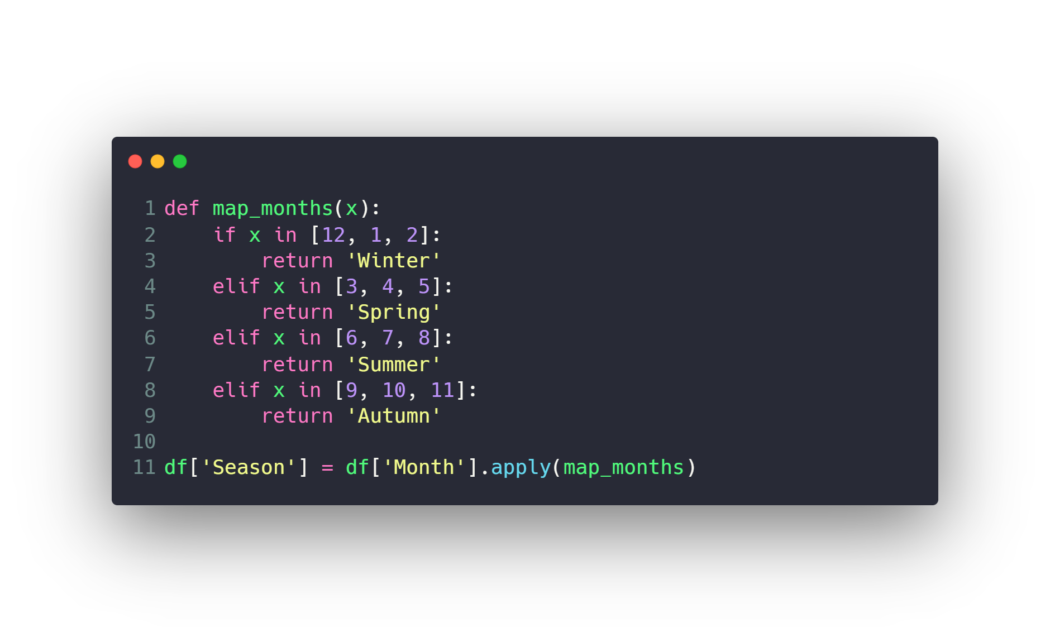
Date and Time features
Extract day, hour, minute, seconds, quarter, month, year, etc.
Extract time-based features like evenings, noon, night time etc.
Extract seasonal features like winter, summer, autumn.
Calculate time elapsed between two related Date features.

Slide 26
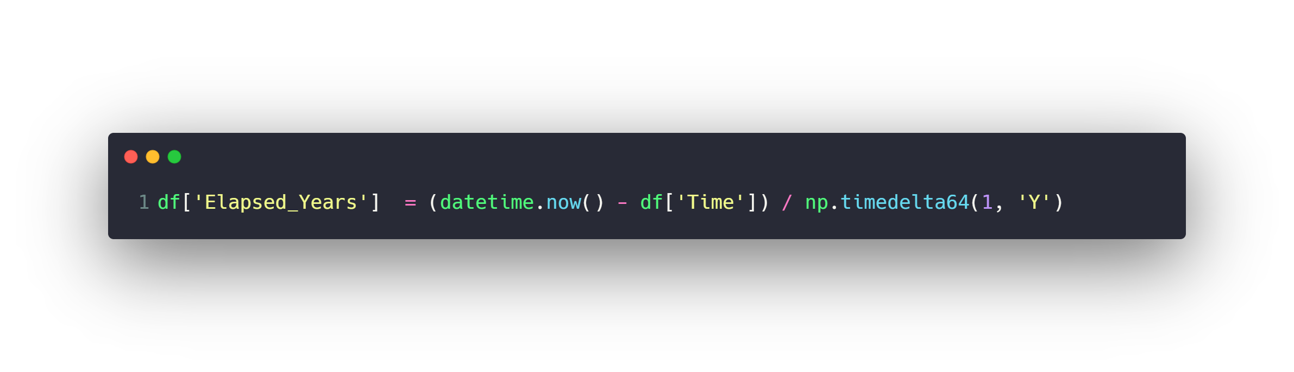
Date and Time features
Extract day, hour, minute, seconds, quarter, month, year, etc.
Extract time-based features like evenings, noon, night time etc.
Extract seasonal features like winter, summer, autumn.
Calculate time elapsed between two related Date features.

Slide 27
Agenda
What is Data
Machine Learning
Data Preprocessing
Feature Engineering and Extraction
Domain knowledge features
Date and Time features
String operations
Web Data
Geospatial features
Work with Text
Work with Images
Work with Audio
Dimension Reduction with PCA
Feature Transformations
Data Cleaning or Cleansing
Work with Missing data
Work with Categorical data
Detect and Handle Outliers
Split data to Train and Test Sets
Deal with Imbalanced classes
Feature Scaling
How to use Pipelines
Feature Selection

Slide 28
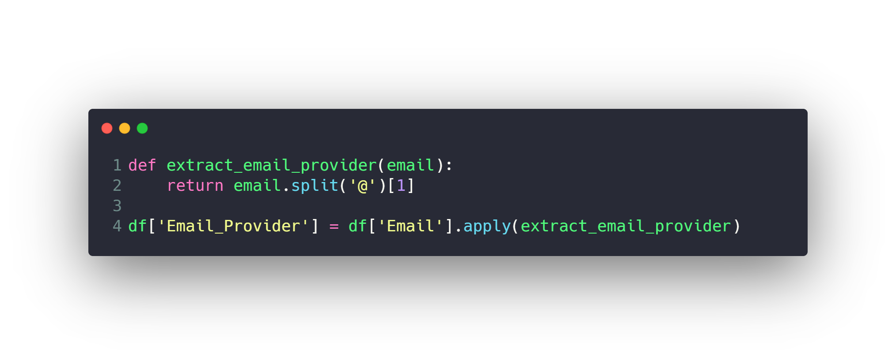
String operations
There is a lot of data hidden within strings, you can use a lot
of string operations techniques to extract those data.

Slide 29
Agenda
What is Data
Machine Learning
Data Preprocessing
Feature Engineering and Extraction
Domain knowledge features
Date and Time features
String operations
Web Data
Geospatial features
Work with Text
Work with Images
Work with Audio
Dimension Reduction with PCA
Feature Transformations
Data Cleaning or Cleansing
Work with Missing data
Work with Categorical data
Detect and Handle Outliers
Split data to Train and Test Sets
Deal with Imbalanced classes
Feature Scaling
How to use Pipelines
Feature Selection

Slide 30
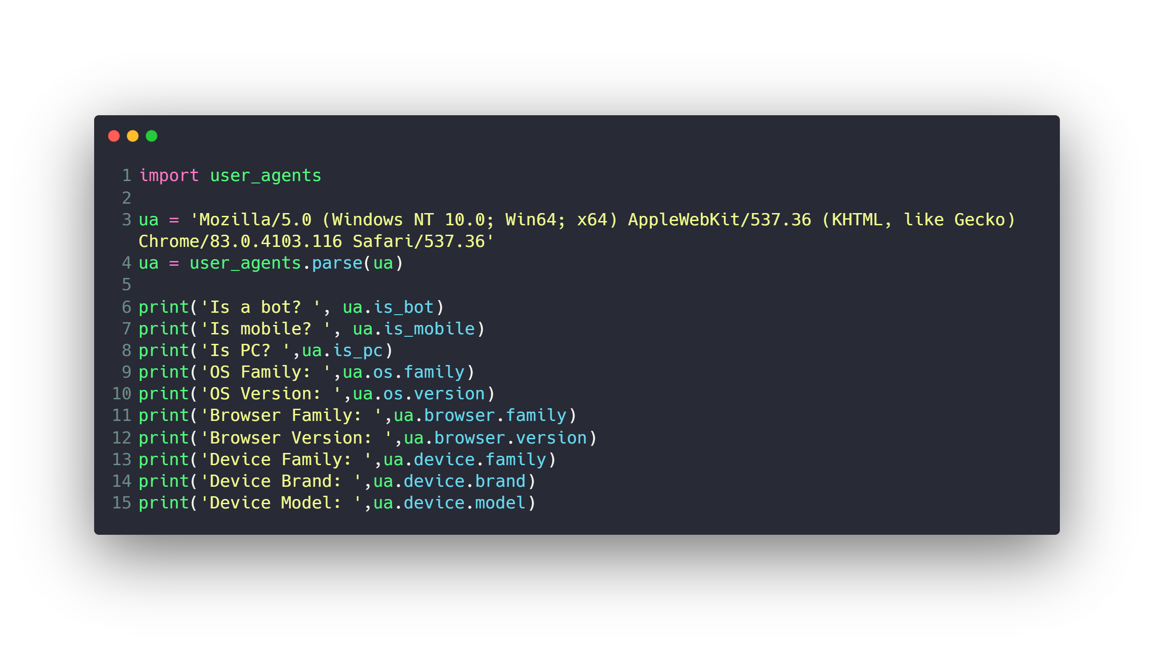
Web Data
There are a lot of web applications data logs like user
agents that contain a lot of info about used browser, OS
and device.

Slide 31
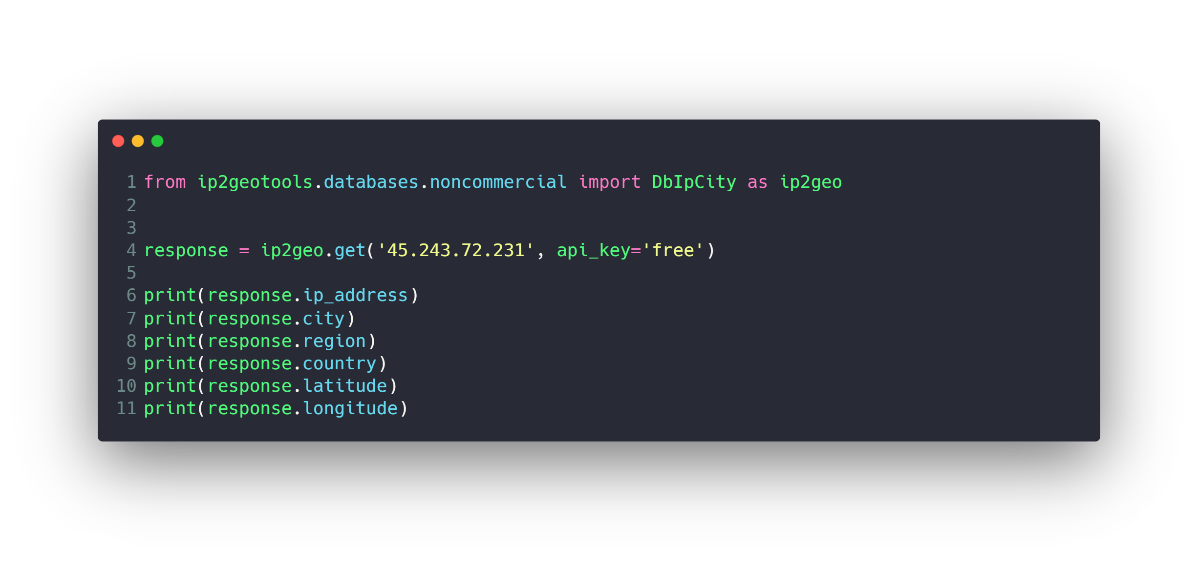
Web Data
IP address is a great way to extract geographical data from it.

Slide 32
Agenda
What is Data
Machine Learning
Data Preprocessing
Feature Engineering and Extraction
Domain knowledge features
Date and Time features
String operations
Web Data
Geospatial features
Work with Text
Work with Images
Work with Audio
Dimension Reduction with PCA
Feature Transformations
Data Cleaning or Cleansing
Work with Missing data
Work with Categorical data
Detect and Handle Outliers
Split data to Train and Test Sets
Deal with Imbalanced classes
Feature Scaling
How to use Pipelines
Feature Selection

Slide 33
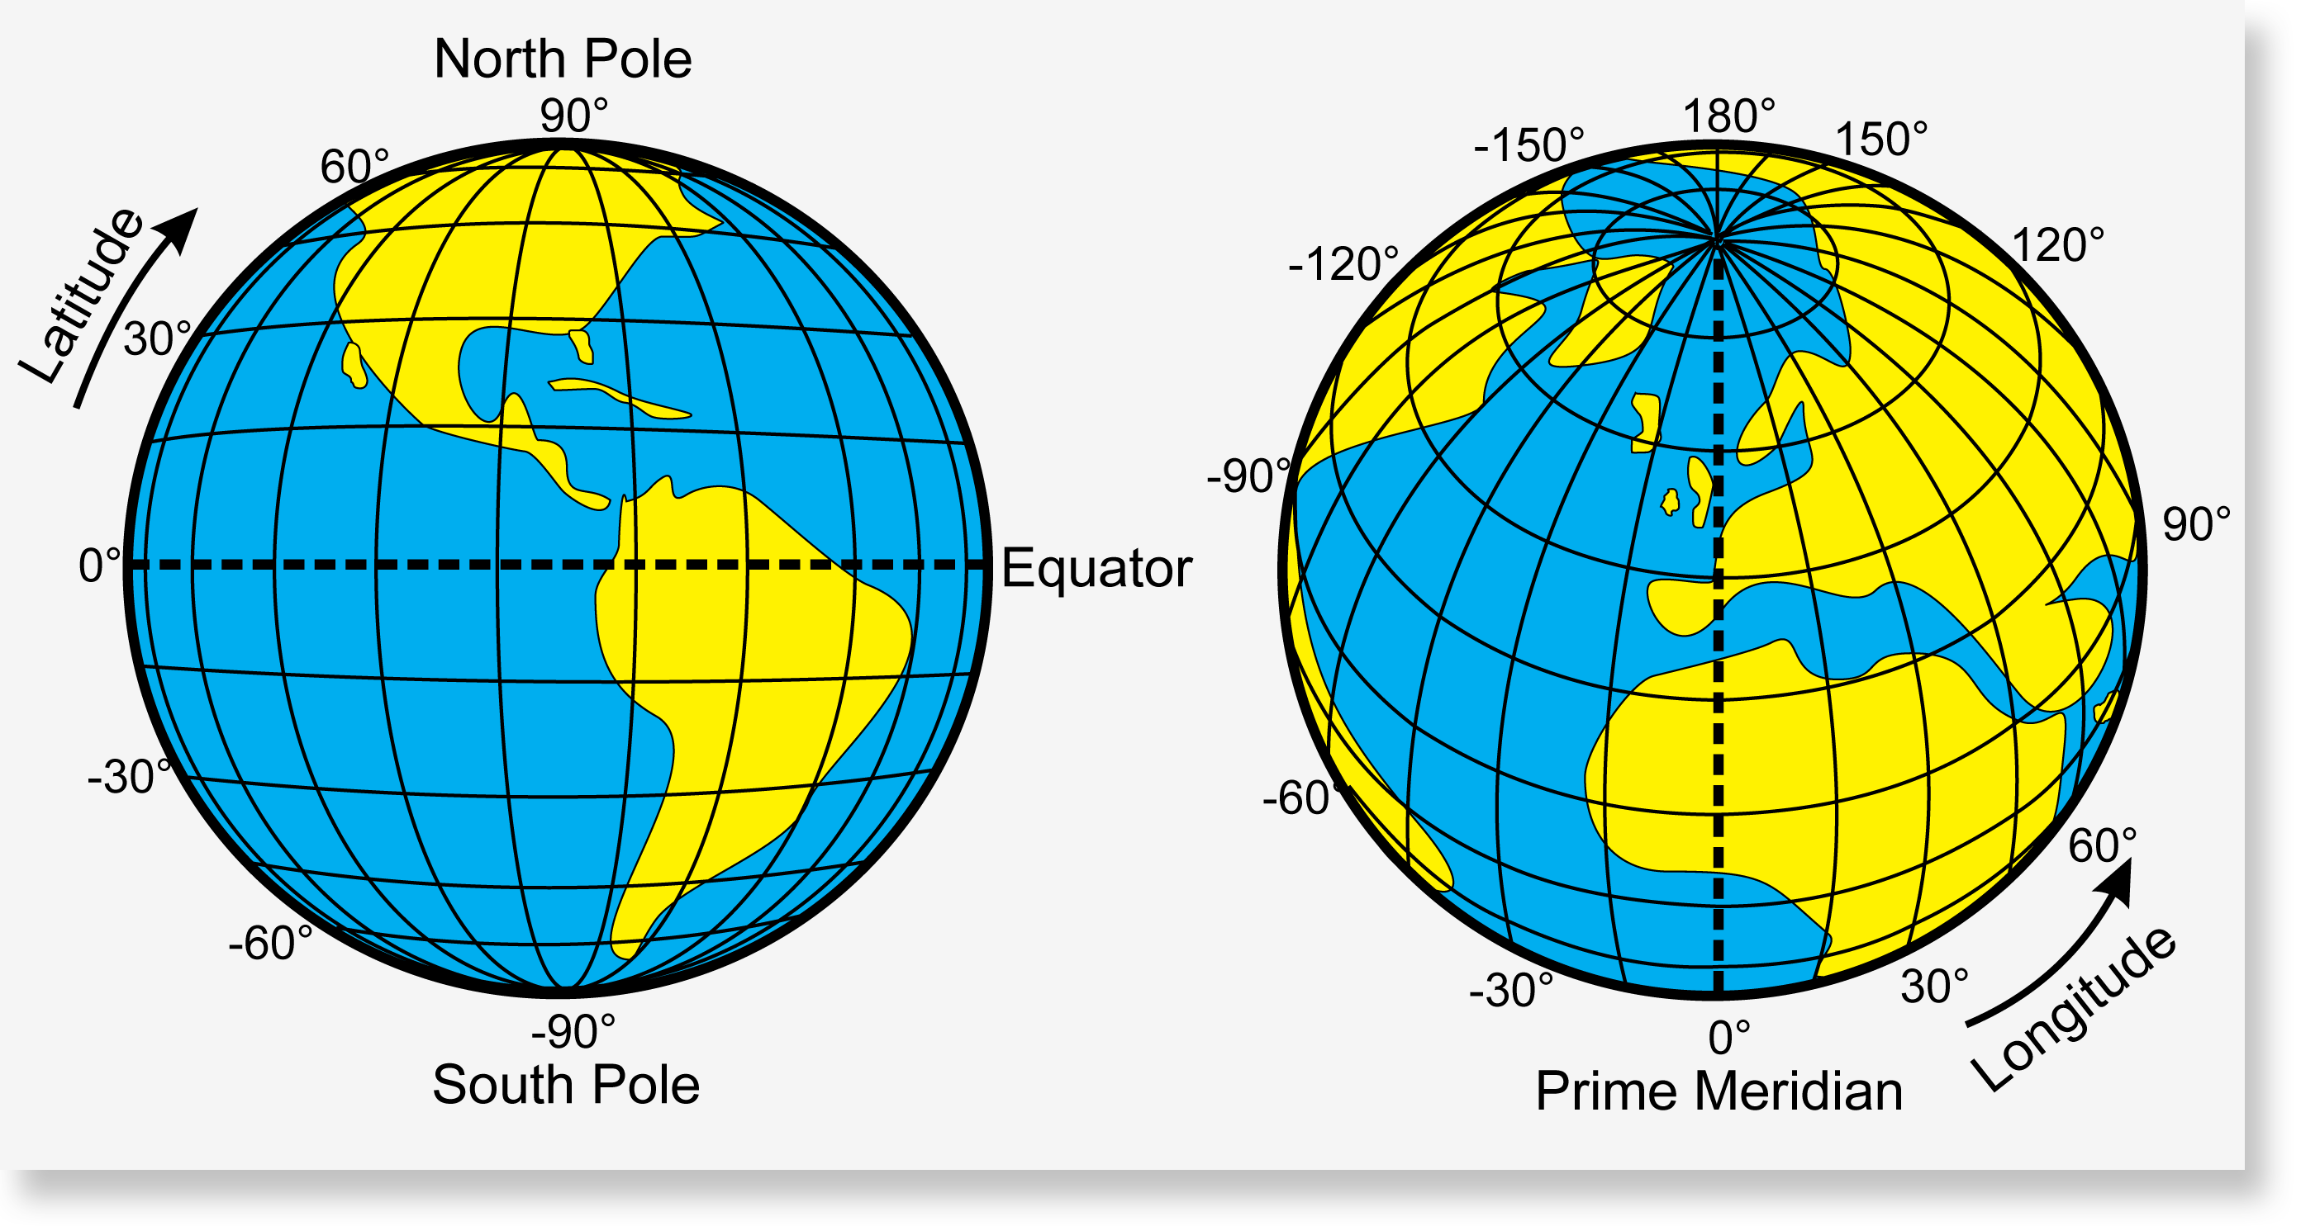
Geospatial features

Slide 34
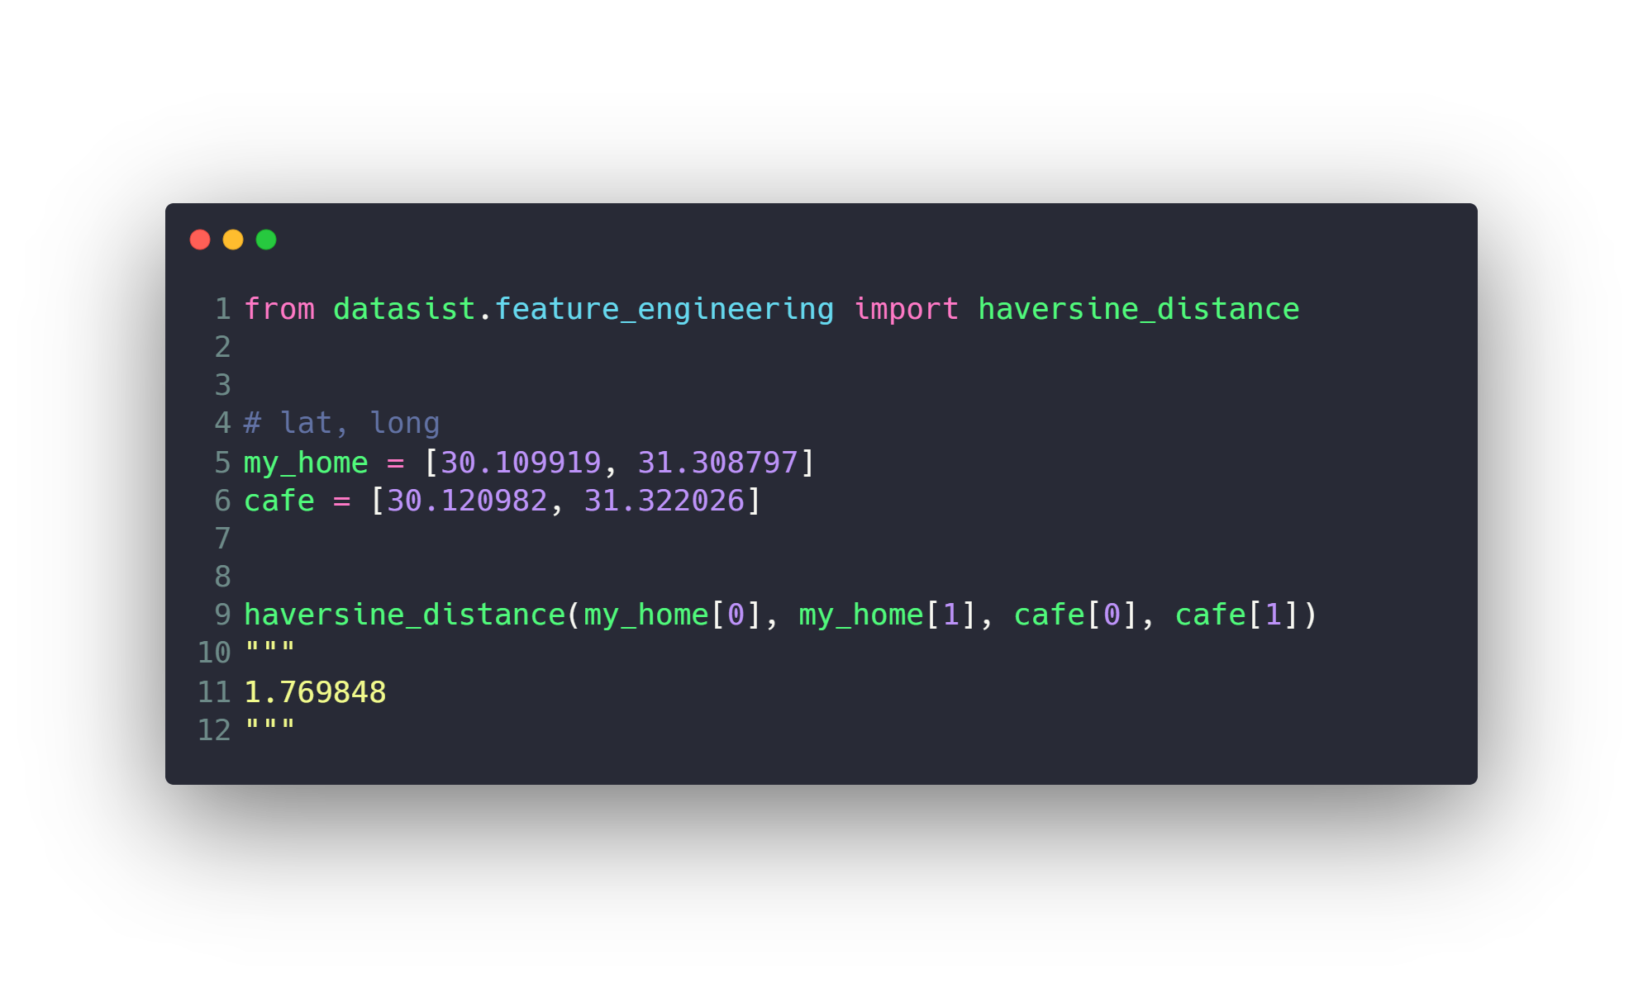
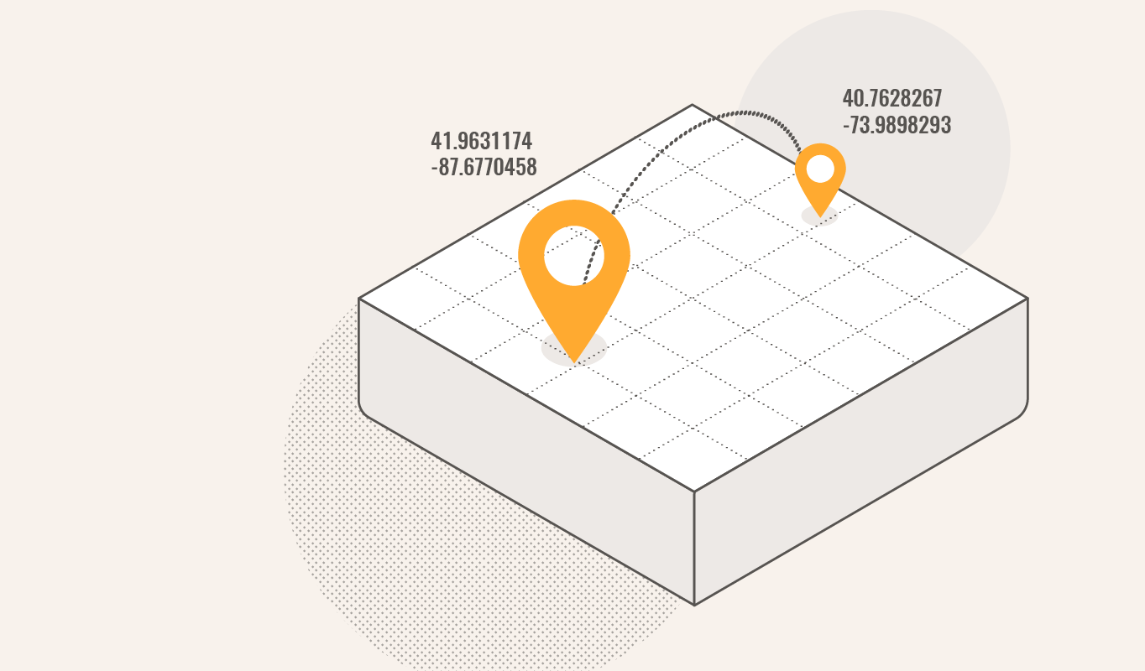
Geospatial features
Measure distance with haversine_distance
https://www.movable-type.co.uk/scripts/latlong.html

Slide 35
Agenda
What is Data
Machine Learning
Data Preprocessing
Feature Engineering and Extraction
Domain knowledge features
Date and Time features
String operations
Web Data
Geospatial features
Work with Text
Work with Images
Work with Audio
Dimension Reduction with PCA
Feature Transformations
Data Cleaning or Cleansing
Work with Missing data
Work with Categorical data
Detect and Handle Outliers
Split data to Train and Test Sets
Deal with Imbalanced classes
Feature Scaling
How to use Pipelines
Feature Selection

Slide 36
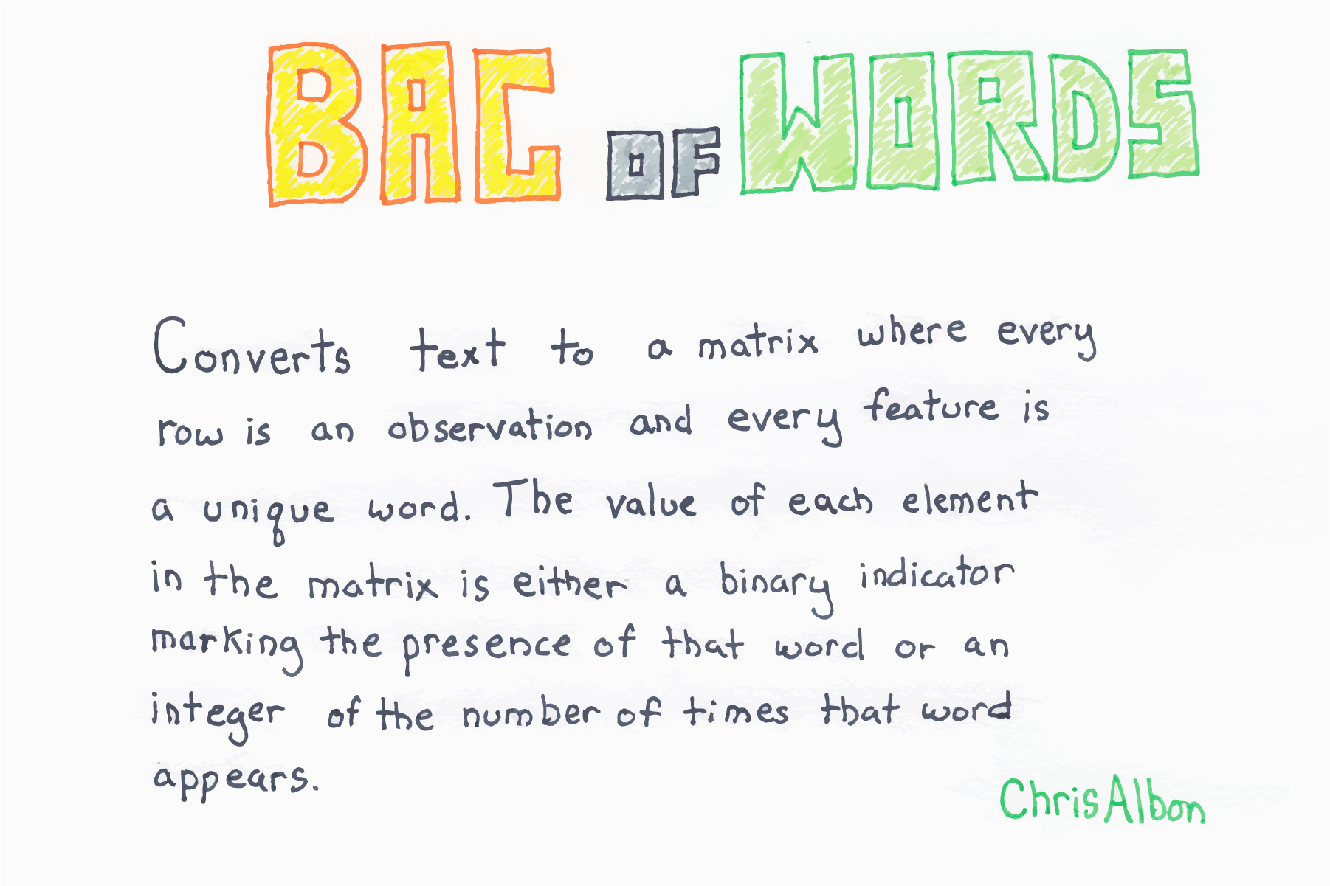
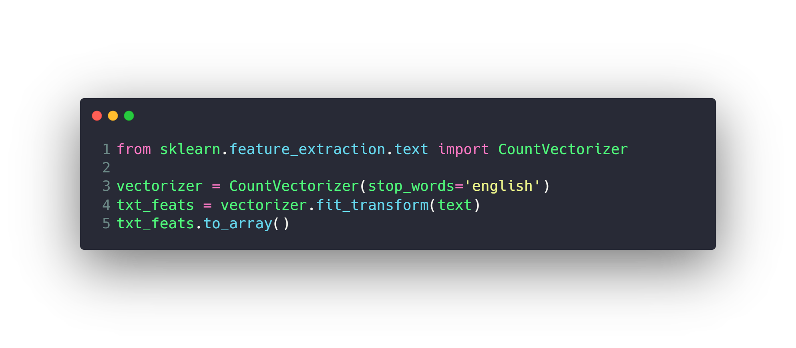
Work with Text

Slide 37
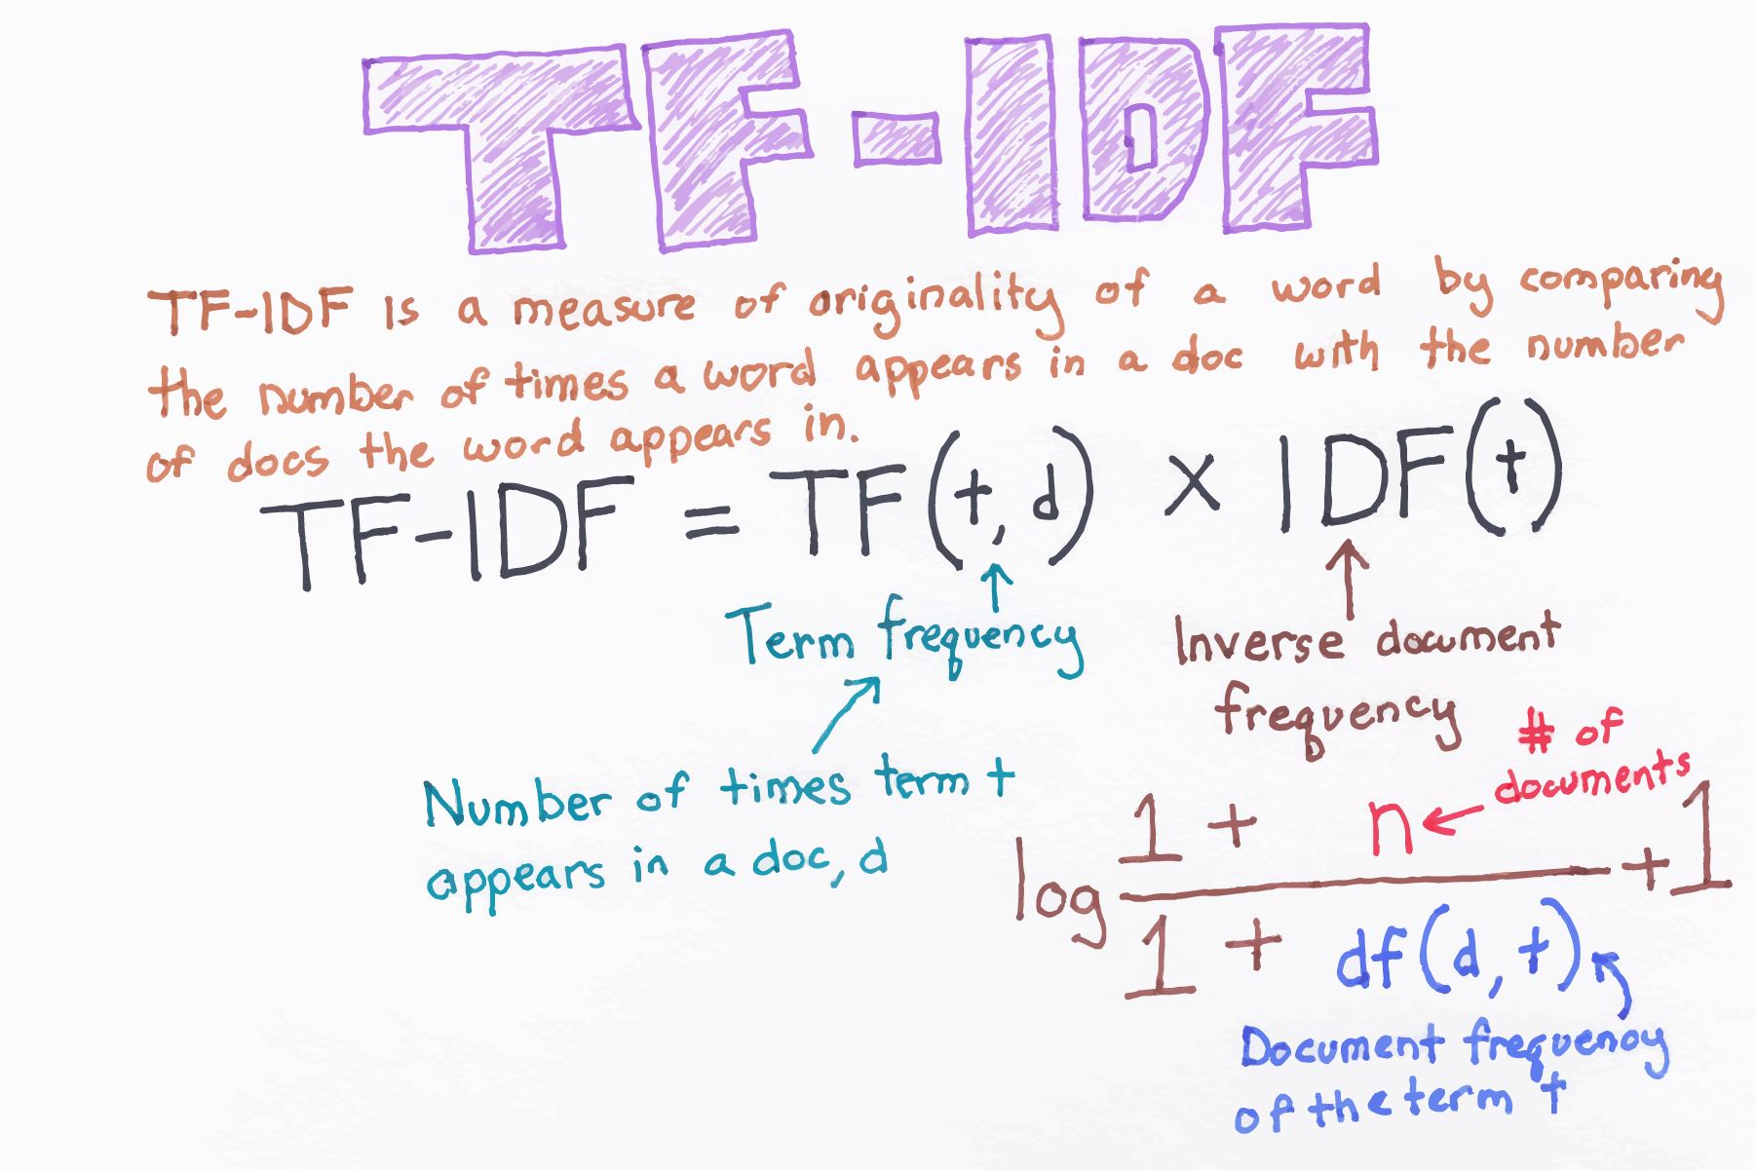
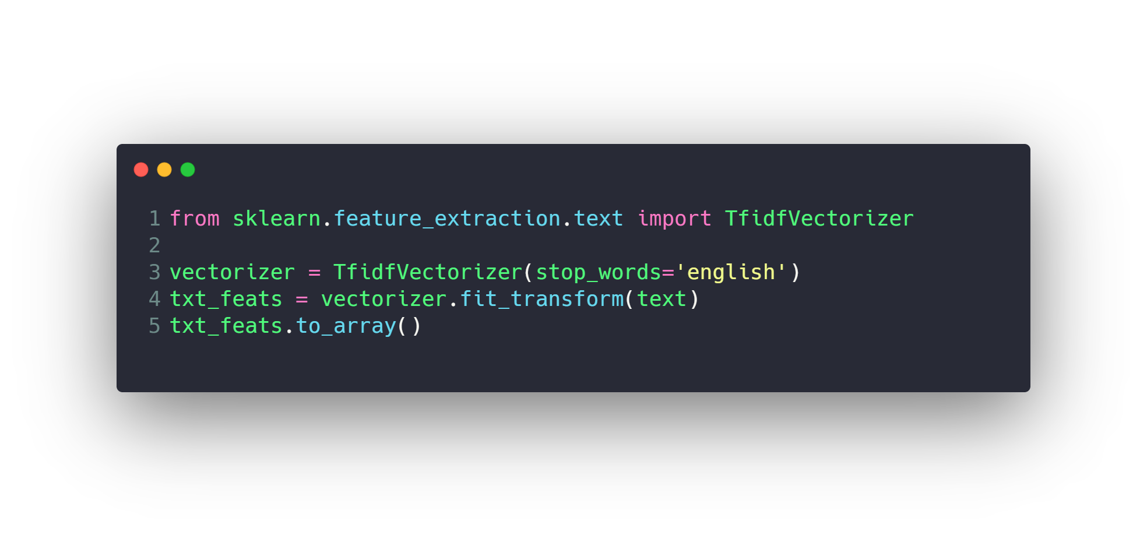
Work with Text

Slide 38
Agenda
What is Data
Machine Learning
Data Preprocessing
Feature Engineering and Extraction
Domain knowledge features
Date and Time features
String operations
Web Data
Geospatial features
Work with Text
Work with Images
Work with Audio
Dimension Reduction with PCA
Feature Transformations
Data Cleaning or Cleansing
Work with Missing data
Work with Categorical data
Detect and Handle Outliers
Split data to Train and Test Sets
Deal with Imbalanced classes
Feature Scaling
How to use Pipelines
Feature Selection

Slide 39
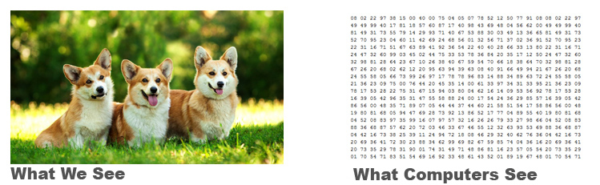
Work with Images

Slide 40

Work with Images
Pixels
Every pixel is one color
Height
Width

Slide 41

Work with Images
RGB Digital Images
We can generate any color by mixing
(red, green, blue) colors with different ratios.

Slide 42
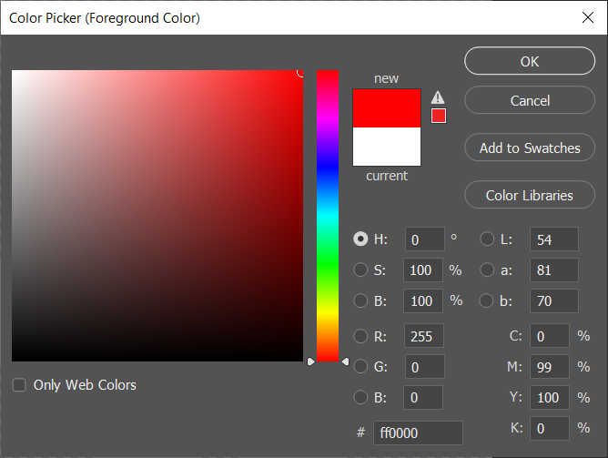
Work with Images (Red)

Slide 43
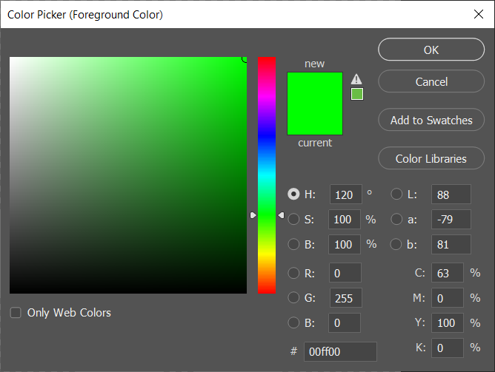
Work with Images (Green)

Slide 44
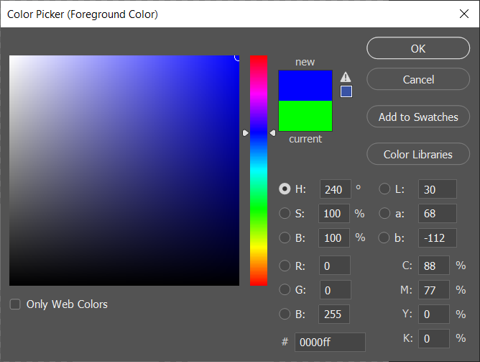
Work with Images (Blue)

Slide 45
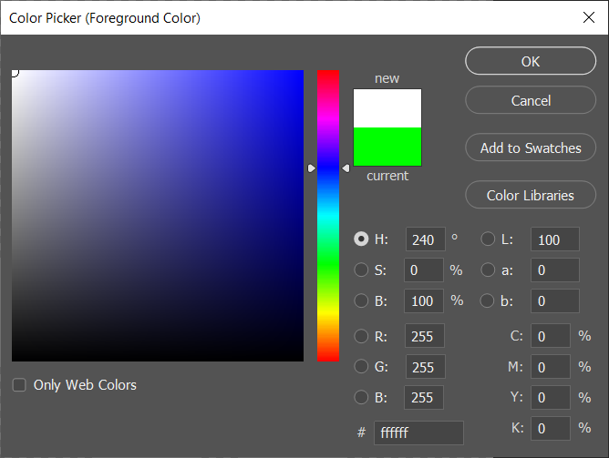
Work with Images (White)

Slide 46

Work with Images (Black)

Slide 47
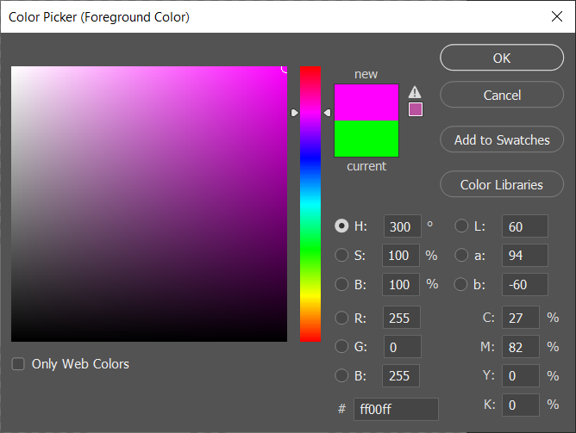
Work with Images (Pink)

Slide 48
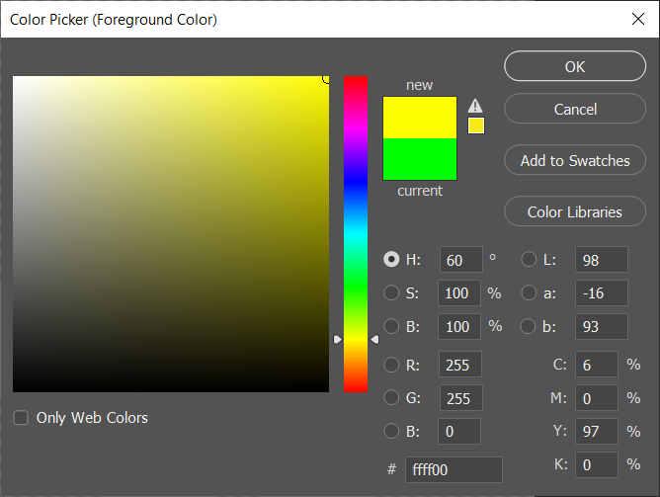
Work with Images (Yellow)

Slide 49
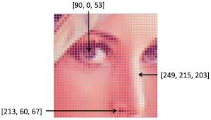
Work with Images
Resolution: 100x100
Width : 100 pixels
Height: 100 pixels

Slide 50
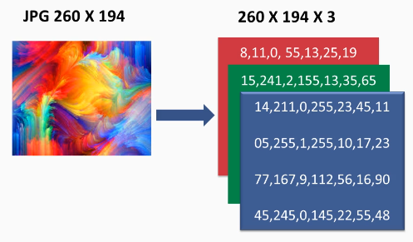
Work with Images

Slide 51
Agenda
What is Data
Machine Learning
Data Preprocessing
Feature Engineering and Extraction
Domain knowledge features
Date and Time features
String operations
Web Data
Geospatial features
Work with Text
Work with Images
Work with Audio
Dimension Reduction with PCA
Feature Transformations
Data Cleaning or Cleansing
Work with Missing data
Work with Categorical data
Detect and Handle Outliers
Split data to Train and Test Sets
Deal with Imbalanced classes
Feature Scaling
How to use Pipelines
Feature Selection

Slide 52
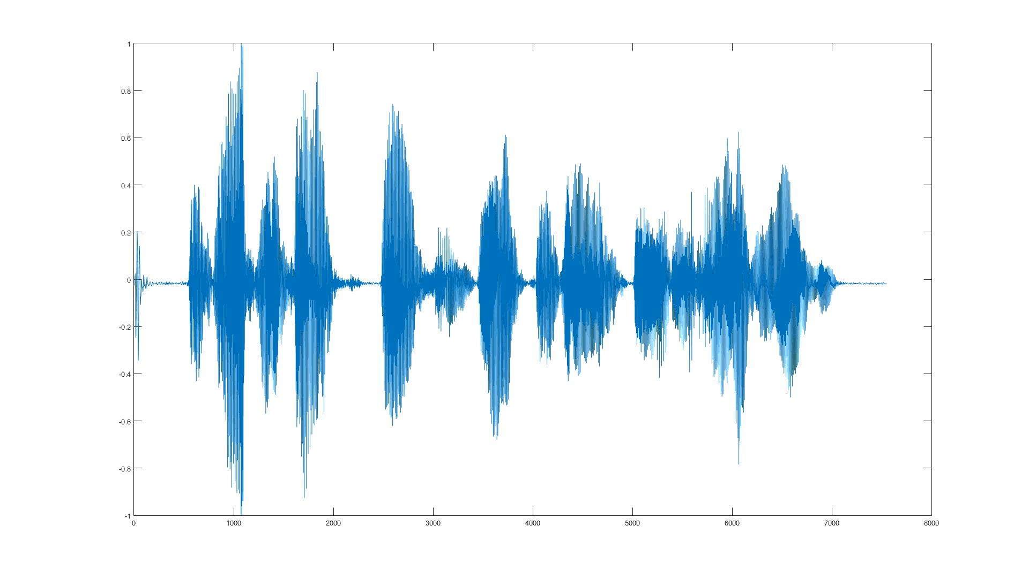
Work with Audio

Slide 53
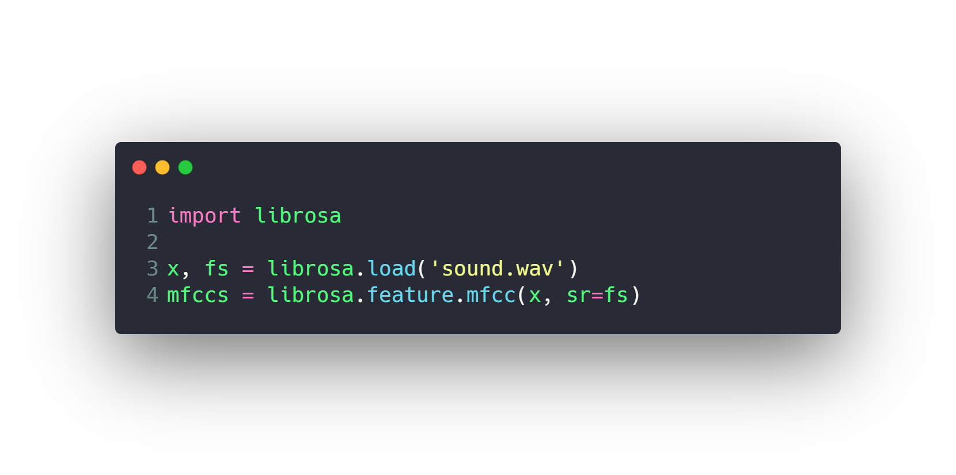
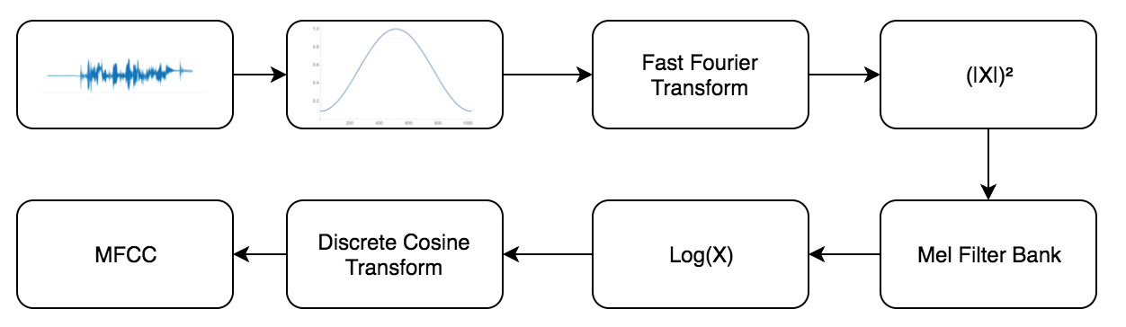
Work with Audio
https://en.wikipedia.org/wiki/Mel-frequency_cepstrum

Slide 54
Agenda
What is Data
Machine Learning
Data Preprocessing
Feature Engineering and Extraction
Domain knowledge features
Date and Time features
String operations
Web Data
Geospatial features
Work with Text
Work with Images
Work with Audio
Dimension Reduction with PCA
Feature Transformations
Data Cleaning or Cleansing
Work with Missing data
Work with Categorical data
Detect and Handle Outliers
Split data to Train and Test Sets
Deal with Imbalanced classes
Feature Scaling
How to use Pipelines
Feature Selection

Slide 55
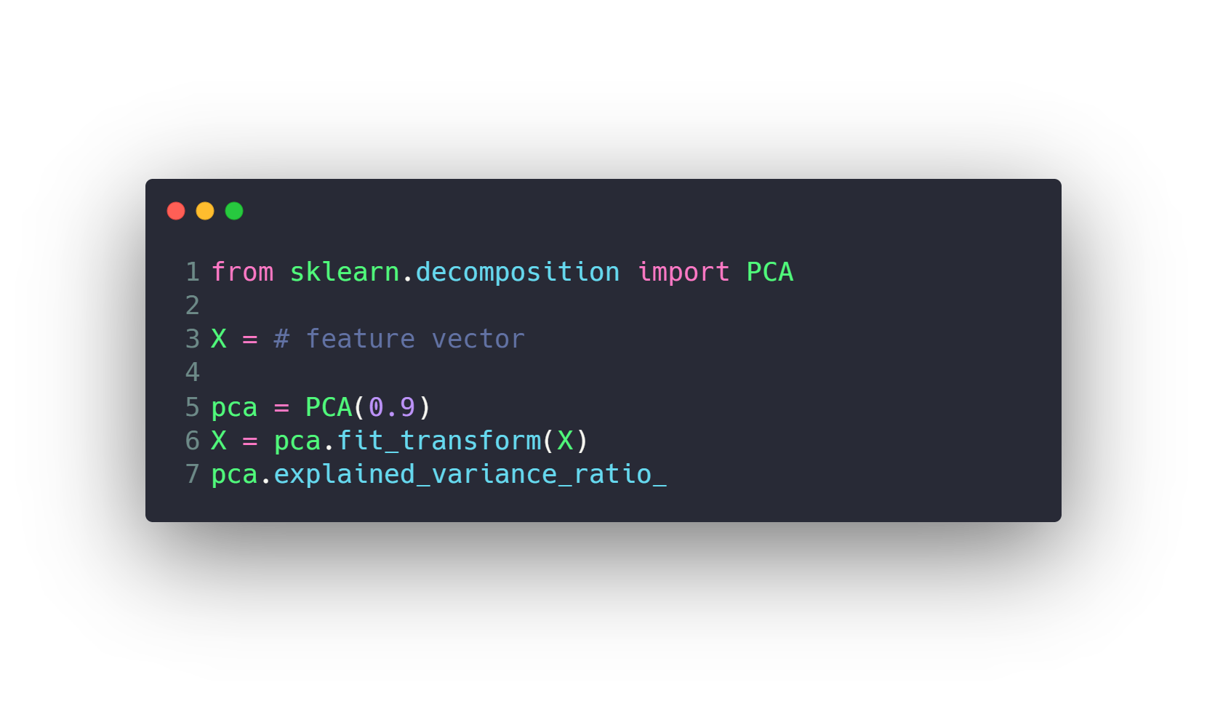
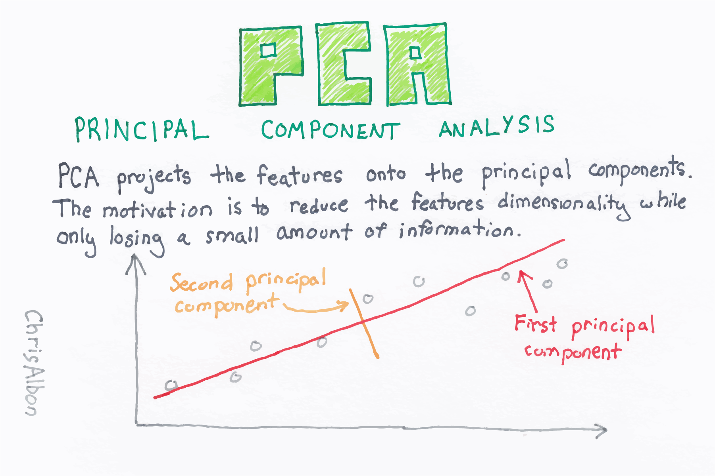
Dimension Reduction with PCA
https://en.wikipedia.org/wiki/Principal_component_analysis

Slide 56
Agenda
What is Data
Machine Learning
Data Preprocessing
Feature Engineering and Extraction
Domain knowledge features
Date and Time features
String operations
Web Data
Geospatial features
Work with Text
Work with Images
Work with Audio
Dimension Reduction with PCA
Feature Transformations
Data Cleaning or Cleansing
Work with Missing data
Work with Categorical data
Detect and Handle Outliers
Split data to Train and Test Sets
Deal with Imbalanced classes
Feature Scaling
How to use Pipelines
Feature Selection

Slide 57

Data Cleaning or Cleansing
Cleaning data is the process of preparing the dataset
for analysis. It is very important because the accuracy
of machine learning or data mining models are affected
because of poor quality of data.
So, data scientists spend a large amount of their time
cleaning the dataset and transform them into a format
with which they can work with. In fact, data scientists
spend 80% of their time cleaning the data.
Example of problems
Columns can have missing data indicators like xx and ?.
Height column can have value of 0.
Weight column can have negative values.
…

Slide 58
Agenda
What is Data
Machine Learning
Data Preprocessing
Feature Engineering and Extraction
Domain knowledge features
Date and Time features
String operations
Web Data
Geospatial features
Work with Text
Work with Images
Work with Audio
Dimension Reduction with PCA
Feature Transformations
Data Cleaning or Cleansing
Work with Missing data
Work with Categorical data
Detect and Handle Outliers
Split data to Train and Test Sets
Deal with Imbalanced classes
Feature Scaling
How to use Pipelines
Feature Selection

Slide 59
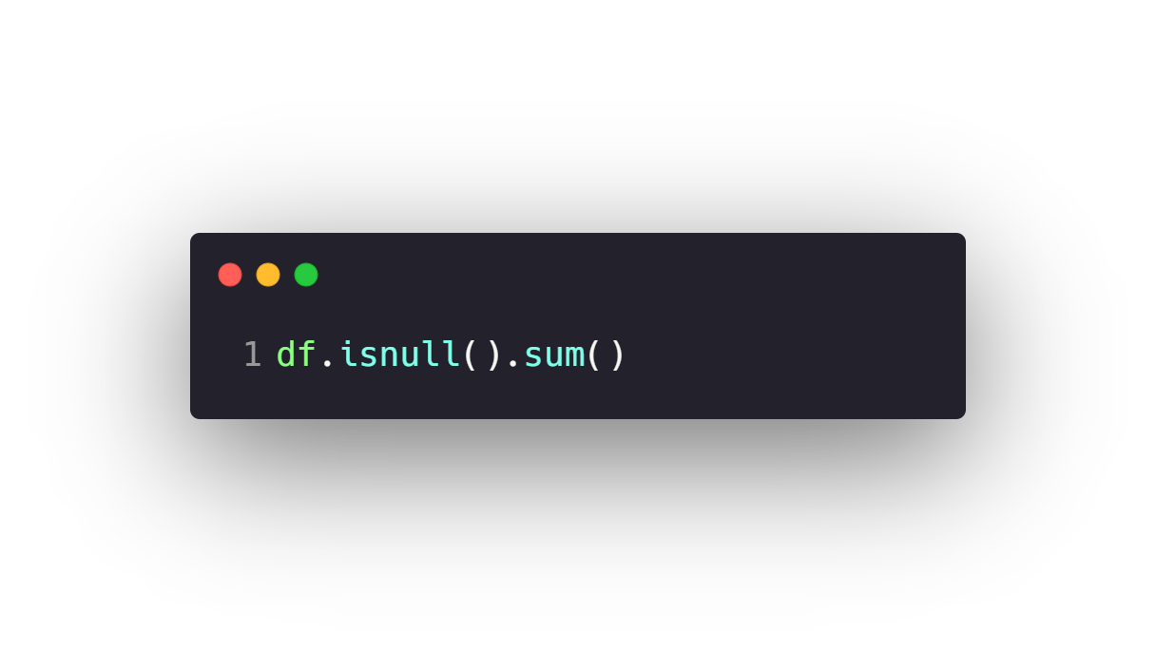
Work with Missing data
Check Missing Data
Drop Missing Data
Fill Missing data with Pandas
Fill Missing data with Sklearn SimpleImputer
Fill Missing data with Sklearn KNNImputer

Slide 60
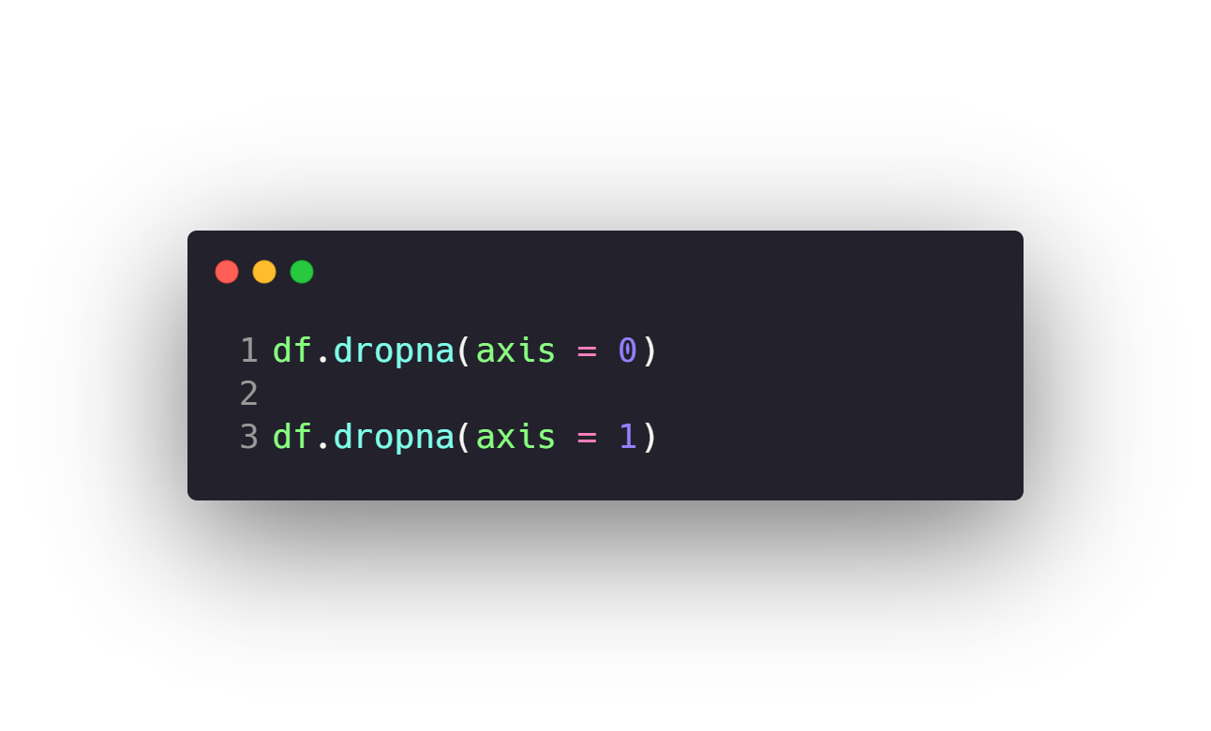
Work with Missing data
Check Missing Data
Drop Missing Data
Fill Missing data with Pandas
Fill Missing data with Sklearn SimpleImputer
Fill Missing data with Sklearn KNNImputer

Slide 61
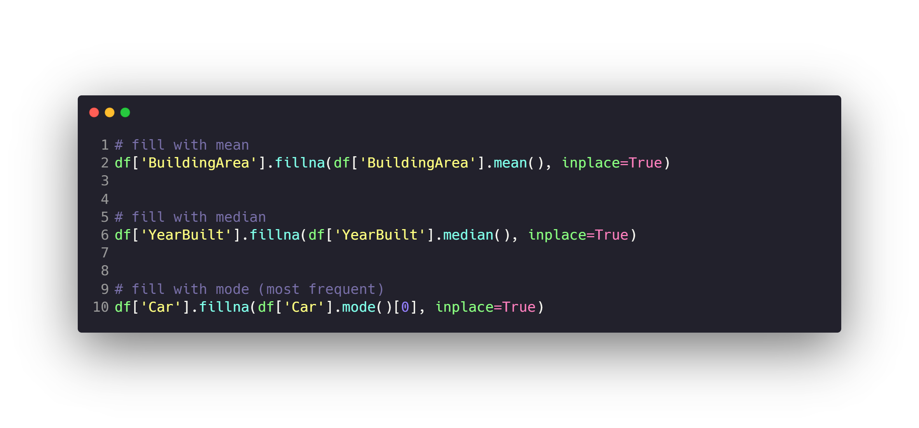
Work with Missing data
Check Missing Data
Drop Missing Data
Fill Missing data with Pandas
Fill Missing data with Sklearn SimpleImputer
Fill Missing data with Sklearn KNNImputer

Slide 62
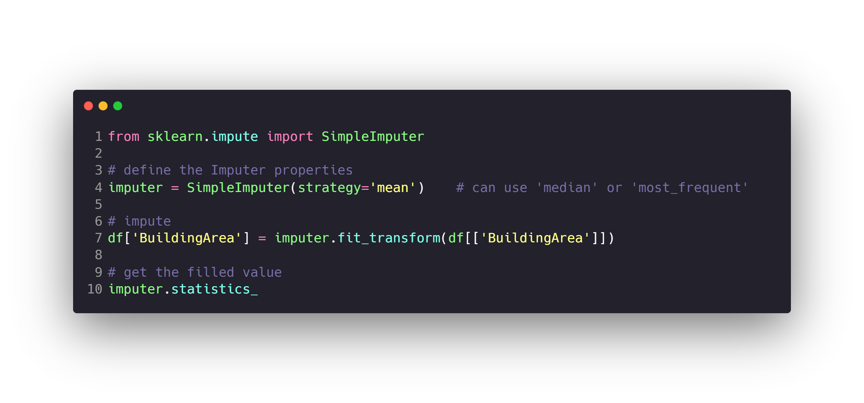
Work with Missing data
Check Missing Data
Drop Missing Data
Fill Missing data with Pandas
Fill Missing data with Sklearn SimpleImputer
Fill Missing data with Sklearn KNNImputer

Slide 63
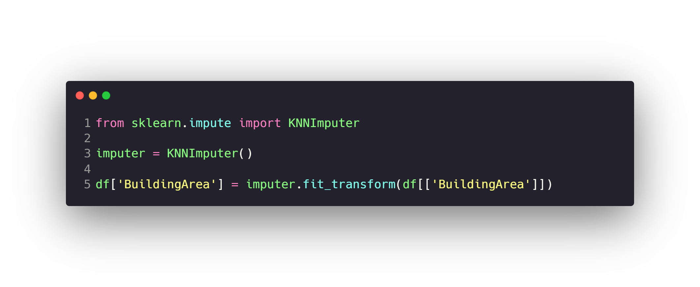
Work with Missing data
Check Missing Data
Drop Missing Data
Fill Missing data with Pandas
Fill Missing data with Sklearn SimpleImputer
Fill Missing data with Sklearn KNNImputer

Slide 64
Agenda
What is Data
Machine Learning
Data Preprocessing
Feature Engineering and Extraction
Domain knowledge features
Date and Time features
String operations
Web Data
Geospatial features
Work with Text
Work with Images
Work with Audio
Dimension Reduction with PCA
Feature Transformations
Data Cleaning or Cleansing
Work with Missing data
Work with Categorical data
Detect and Handle Outliers
Split data to Train and Test Sets
Deal with Imbalanced classes
Feature Scaling
How to use Pipelines
Feature Selection

Slide 65
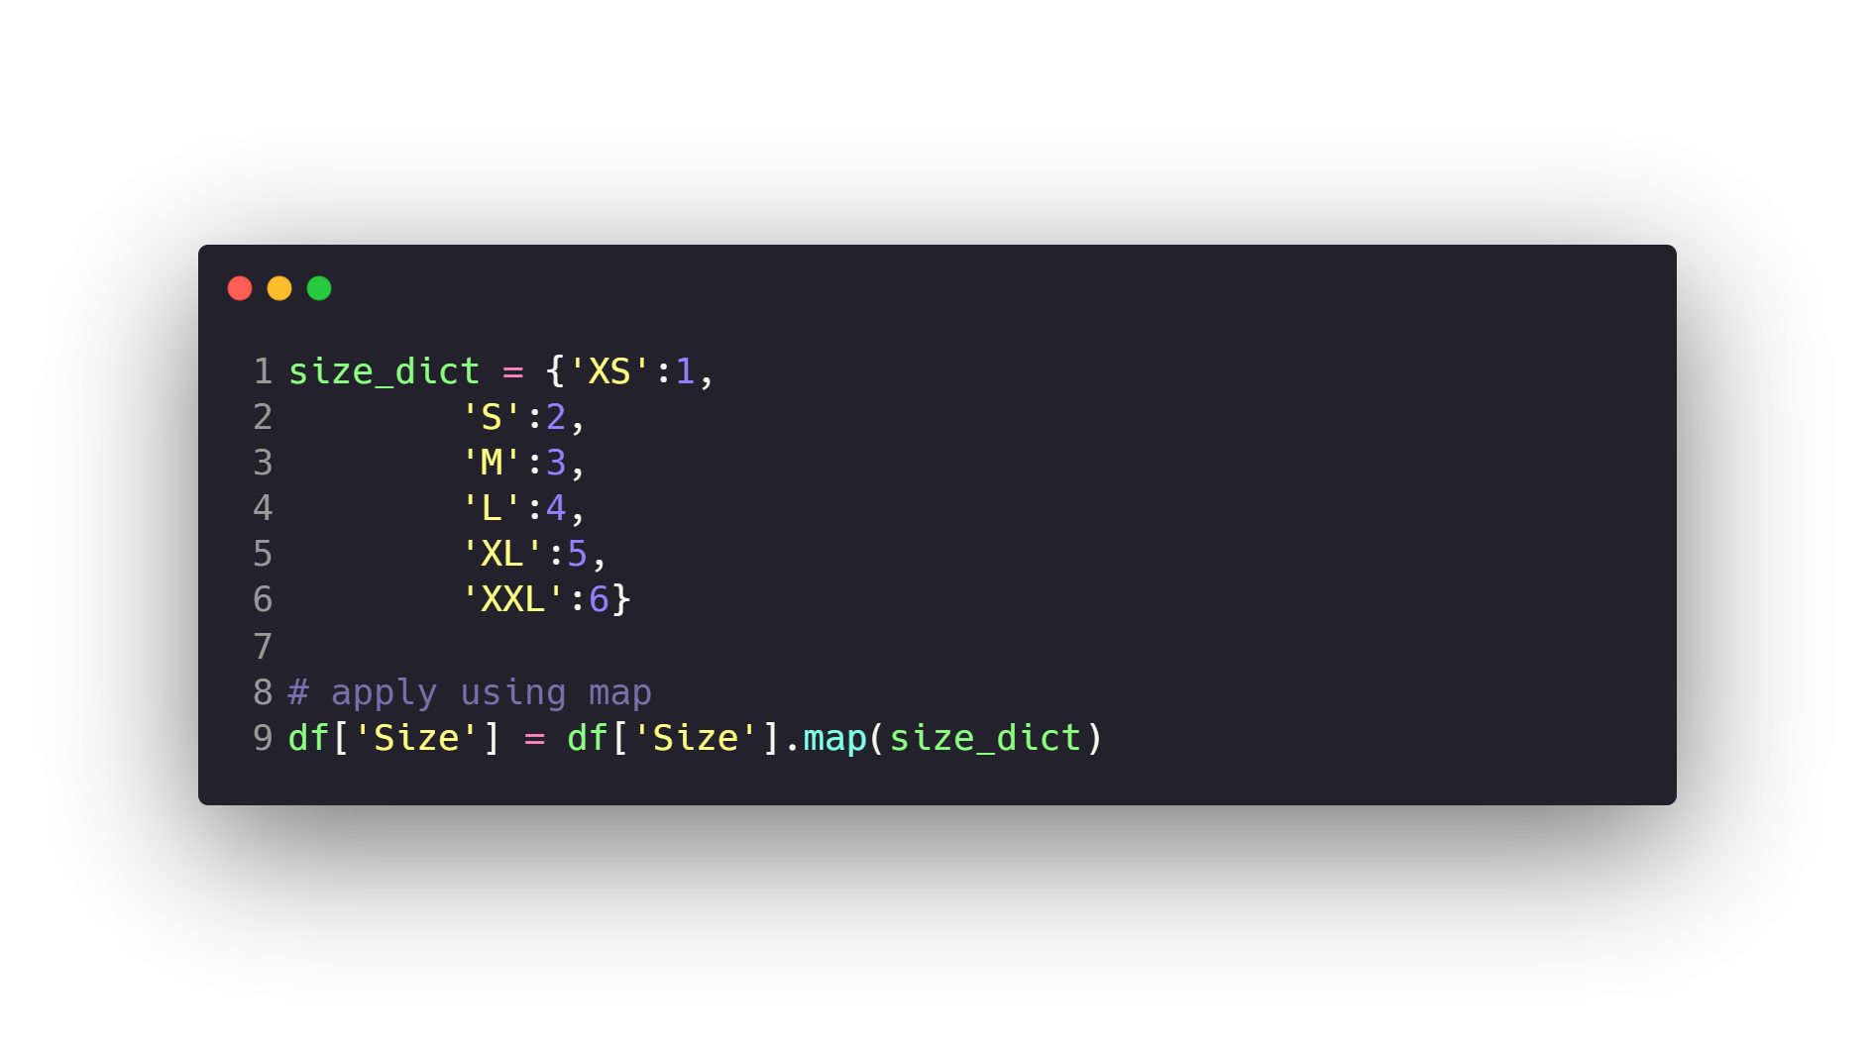
Work with Categorical data
Work with Ordinal Features with pandas map method.
Work with Nominal Features with pandas get_dummies method.

Slide 66
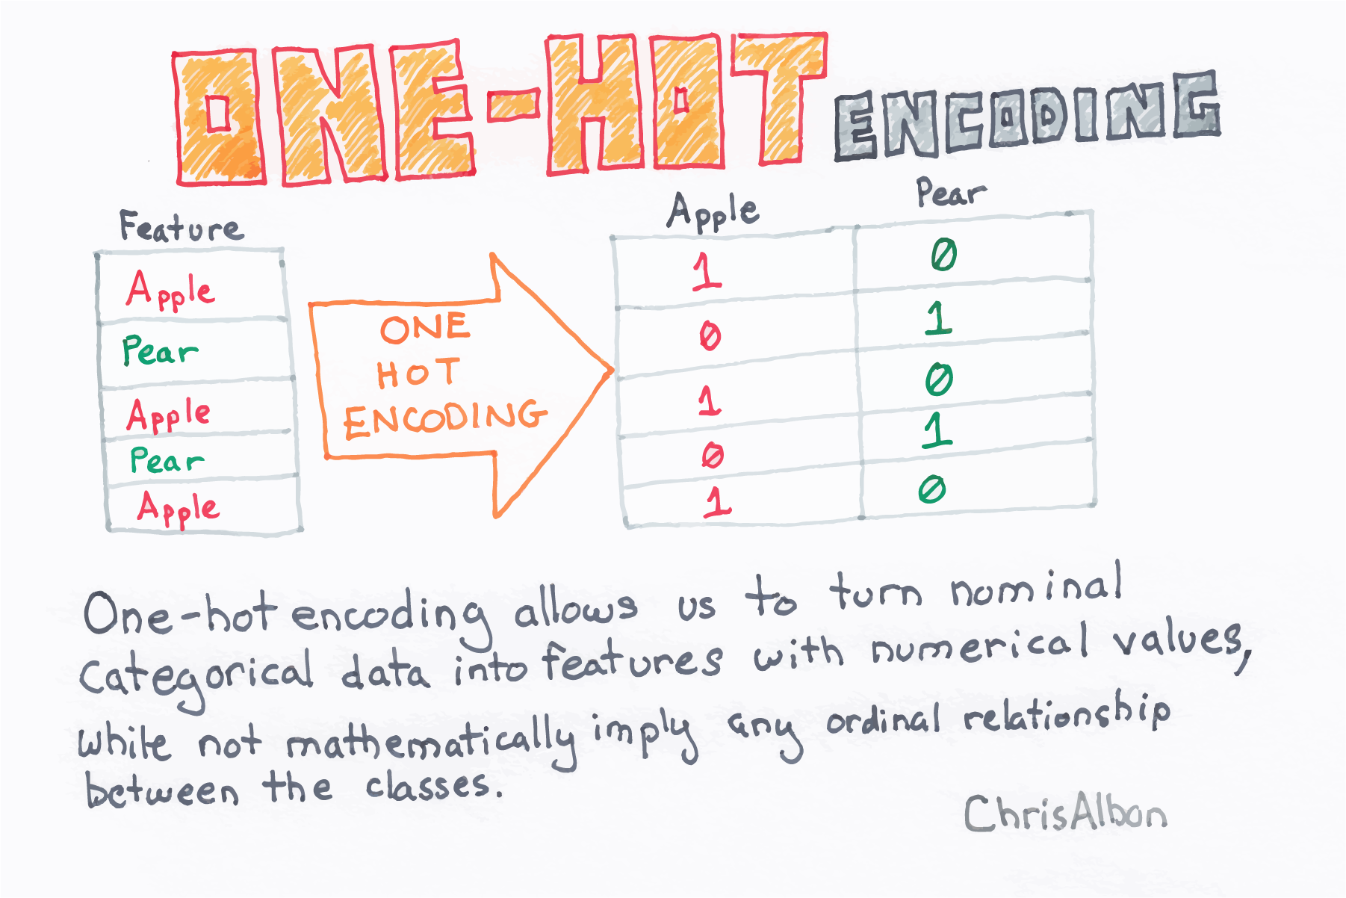
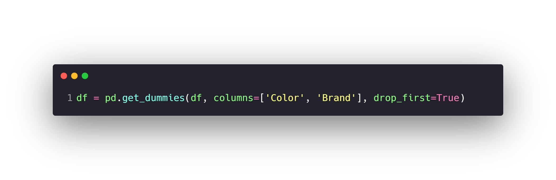
Work with Categorical data
Work with Ordinal Features with pandas map method.
Work with Nominal Features with pandas get_dummies method.

Slide 67
Agenda
What is Data
Machine Learning
Data Preprocessing
Feature Engineering and Extraction
Domain knowledge features
Date and Time features
String operations
Web Data
Geospatial features
Work with Text
Work with Images
Work with Audio
Dimension Reduction with PCA
Feature Transformations
Data Cleaning or Cleansing
Work with Missing data
Work with Categorical data
Detect and Handle Outliers
Split data to Train and Test Sets
Deal with Imbalanced classes
Feature Scaling
How to use Pipelines
Feature Selection

Slide 68
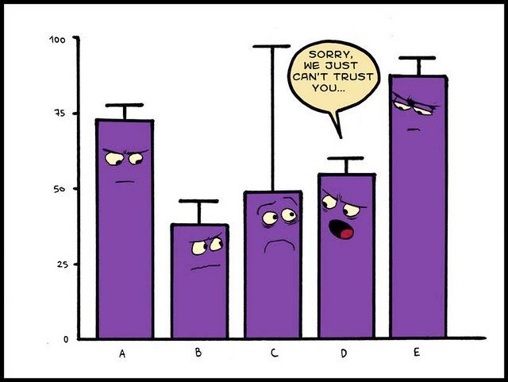
Detect and Handle Outliers
In statistics, an outlier is a data point that differs significantly
from other observations.
An outlier may be due to variability in the measurement or it
may indicate experimental error, the latter are sometimes
excluded from the data set.
An outlier can cause serious problems in statistical analyses.

Slide 69
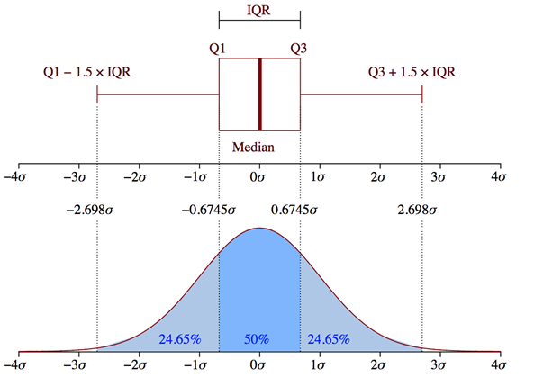
Detect and Handle Outliers

Slide 70
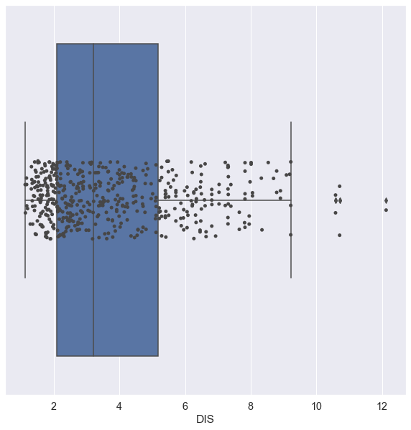
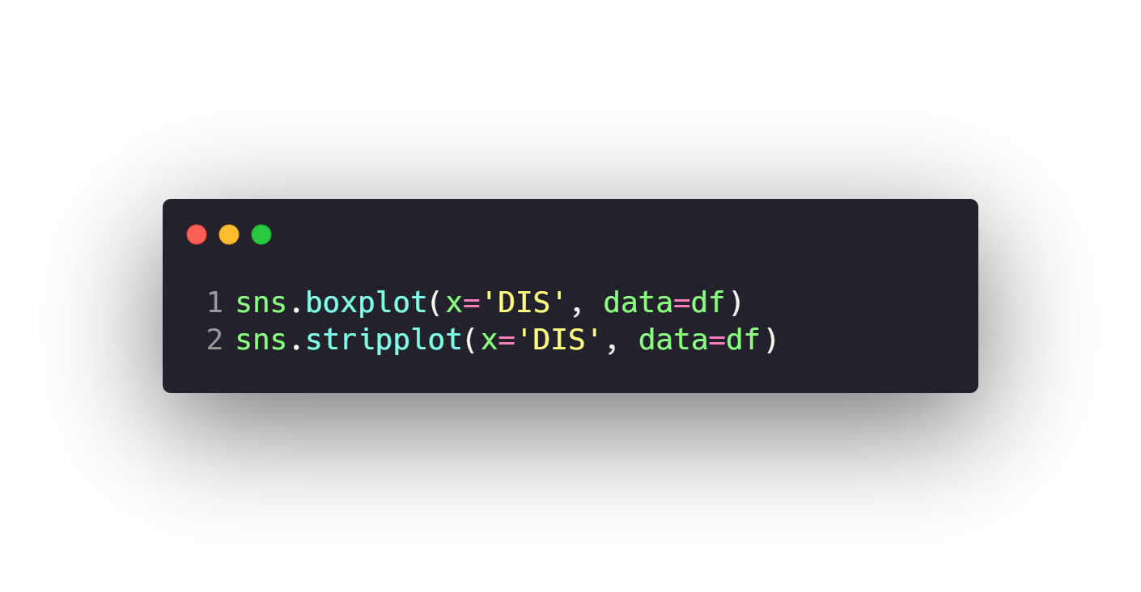
Detect and Handle Outliers
Detect Outliers with Visualization.
Detect and Handle Outliers with Z-Score.
Detect and Handle Outliers with IQR.

Slide 71
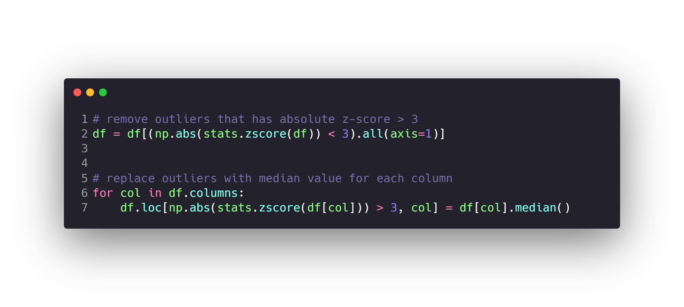

Detect and Handle Outliers
Detect Outliers with Visualization.
Detect and Handle Outliers with Z-Score.
Detect and Handle Outliers with IQR.

Slide 72


Detect and Handle Outliers
Detect Outliers with Visualization.
Detect and Handle Outliers with Z-Score.
Detect and Handle Outliers with IQR.

Slide 73
Agenda
What is Data
Machine Learning
Data Preprocessing
Feature Engineering and Extraction
Domain knowledge features
Date and Time features
String operations
Web Data
Geospatial features
Work with Text
Work with Images
Work with Audio
Dimension Reduction with PCA
Feature Transformations
Data Cleaning or Cleansing
Work with Missing data
Work with Categorical data
Detect and Handle Outliers
Split data to Train and Test Sets
Deal with Imbalanced classes
Feature Scaling
How to use Pipelines
Feature Selection

Slide 74


Split data to Train and Test Sets
When you’re working on a model and want to train it, you
obviously have a dataset. But after training, we have to test
the model on some test dataset.
the obvious solution is to split the dataset you have into two
sets, one for training and the other for testing; and you do this
before you start training your model.

Slide 75
Agenda
What is Data
Machine Learning
Data Preprocessing
Feature Engineering and Extraction
Domain knowledge features
Date and Time features
String operations
Web Data
Geospatial features
Work with Text
Work with Images
Work with Audio
Dimension Reduction with PCA
Feature Transformations
Data Cleaning or Cleansing
Work with Missing data
Work with Categorical data
Detect and Handle Outliers
Split data to Train and Test Sets
Deal with Imbalanced classes
Feature Scaling
How to use Pipelines
Feature Selection

Slide 76

Deal with Imbalanced classes
Imbalanced classes are a common problem in machine learning classification where there are an unbalanced ratio of
observations in each class. Class imbalance can be found in many different areas including medical diagnosis, spam
filtering, and fraud detection.

Slide 77


Deal with Imbalanced classes
Up-sampling or Over-sampling Minority Class
Down-sampling or Under-sampling Majority Class
Generate Synthetic Samples with SMOTE

Slide 78


Deal with Imbalanced classes
Up-sampling or Over-sampling Minority Class
Down-sampling or Under-sampling Majority Class
Generate Synthetic Samples with SMOTE

Slide 79


Deal with Imbalanced classes
Up-sampling or Over-sampling Minority Class
Down-sampling or Under-sampling Majority Class
Generate Synthetic Samples with SMOTE

Slide 80
Agenda
What is Data
Machine Learning
Data Preprocessing
Feature Engineering and Extraction
Domain knowledge features
Date and Time features
String operations
Web Data
Geospatial features
Work with Text
Work with Images
Work with Audio
Dimension Reduction with PCA
Feature Transformations
Data Cleaning or Cleansing
Work with Missing data
Work with Categorical data
Detect and Handle Outliers
Split data to Train and Test Sets
Deal with Imbalanced classes
Feature Scaling
How to use Pipelines
Feature Selection

Slide 81


Feature Scaling
Normalization with Sklearn MinMaxScaler.
Standardizing data with StandardScaler.
Rescaling using RobustScaler.

Slide 82


Feature Scaling
Normalization with Sklearn MinMaxScaler.
Standardizing data with StandardScaler.
Rescaling using RobustScaler.

Slide 83


Feature Scaling
Normalization with Sklearn MinMaxScaler.
Standardizing data with StandardScaler.
Rescaling using RobustScaler.

Slide 84
Agenda
What is Data
Machine Learning
Data Preprocessing
Feature Engineering and Extraction
Domain knowledge features
Date and Time features
String operations
Web Data
Geospatial features
Work with Text
Work with Images
Work with Audio
Dimension Reduction with PCA
Feature Transformations
Data Cleaning or Cleansing
Work with Missing data
Work with Categorical data
Detect and Handle Outliers
Split data to Train and Test Sets
Deal with Imbalanced classes
Feature Scaling
How to use Pipelines
Feature Selection

Slide 85

How to use Pipelines

Slide 86
Agenda
What is Data
Machine Learning
Data Preprocessing
Feature Engineering and Extraction
Domain knowledge features
Date and Time features
String operations
Web Data
Geospatial features
Work with Text
Work with Images
Work with Audio
Dimension Reduction with PCA
Feature Transformations
Data Cleaning or Cleansing
Work with Missing data
Work with Categorical data
Detect and Handle Outliers
Split data to Train and Test Sets
Deal with Imbalanced classes
Feature Scaling
How to use Pipelines
Feature Selection

Slide 87
Feature Selection
In machine learning, feature selection is the process of choosing a subset of input features that contribute the most to
the output feature for use in model construction.
Feature selection is substantially important if we have datasets with high dimensionality (i.e., large number of features).
High-dimensional datasets are not preferred because they have lengthy training time and have high risk of overfitting.
Feature selection helps to mitigate these problems by selecting features that have high importance to the model, such
that the data dimensionality can be reduced without much loss of the total information.
Some benefits of feature selection are:
1. Reduce training time
2. Reduce the risk of overfitting
3. Potentially increase model's performance
4. Reduce model's complexity such that interpretation becomes easier

Slide 88
Feature Selection
In filter methods, features are selected independently from any machine algorithms.
Filter methods generally use a specific criteria, such as scores in statistical test and
variances, to rank the importance of individual features.
Filter Methods
Wrapper Methods
Embedded Methods
Pearson’s Correlation Coefficient with f_regression()
Mutual Information for regression using mutual_info_regression()
ANOVA for numeric feature using f_classif()
Chi-squared for categorical feature using chi2()
Mutual Information for classification using mutual_info_classif()

Slide 89
Feature Selection
Wrapper methods try to find a subset of features that yield the best performance for
a model by training, evaluating, and comparing the model with different combinations
of features.
Filter Methods
Wrapper Methods
Embedded Methods
Recursive Feature Elimination with RFE()

Slide 90
Feature Selection
Embedded methods combine the strong points of filter and wrapper methods by
taking advantage of machine algorithms that have their own built-in feature selection
process. They integrate a feature selection step as a part of the training process
Filter Methods
Wrapper Methods
Embedded Methods
LASSO & Ridge regression
Decision trees & Random forests
Support vector machines

Slide 91
Questions ?!

Slide 92

Thanks! >_ Live long and prosper

